Slide 1
Project
Improving the quality of homestay services in tourism development in Lang Can town, Lam Binh district, Tuyen Quang province

Slide 2
Group members
Thu Viễn
Thuỳ Giang
Kim Oanh
Phương Anh

Slide 3
Introduction
Tuyên Quang, located in northern Vietnam, boasts stunning natural landscapes and a rich cultural heritage. The Lâm Bình District, home to 12 ethnic groups such as the Tày, Dao, and Mông, has preserved traditional languages, customs, and architectural styles. Recognizing the area's potential, local authorities have promoted community-based homestay tourism to sustain cultural heritage and improve livelihoods
In 2017, the district initiated a model to develop cultural tourism villages, involving 15 households. These efforts included training programs, infrastructure upgrades, and introducing new activities like kayaking, cycling, and cultural performances. Despite progress, there remains a pressing need to enhance service quality to attract more visitors and ensure sustainable growth.

Slide 4
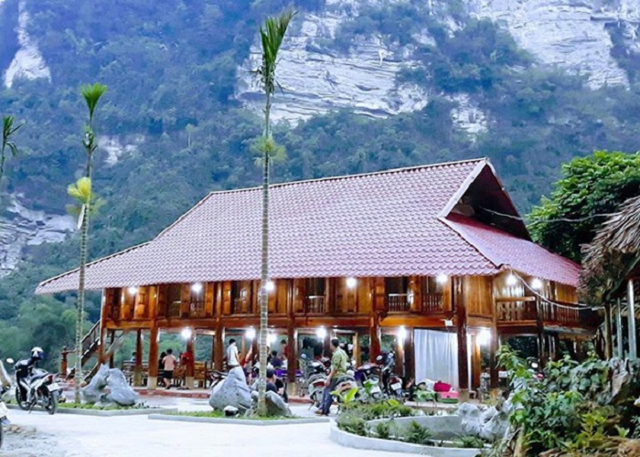
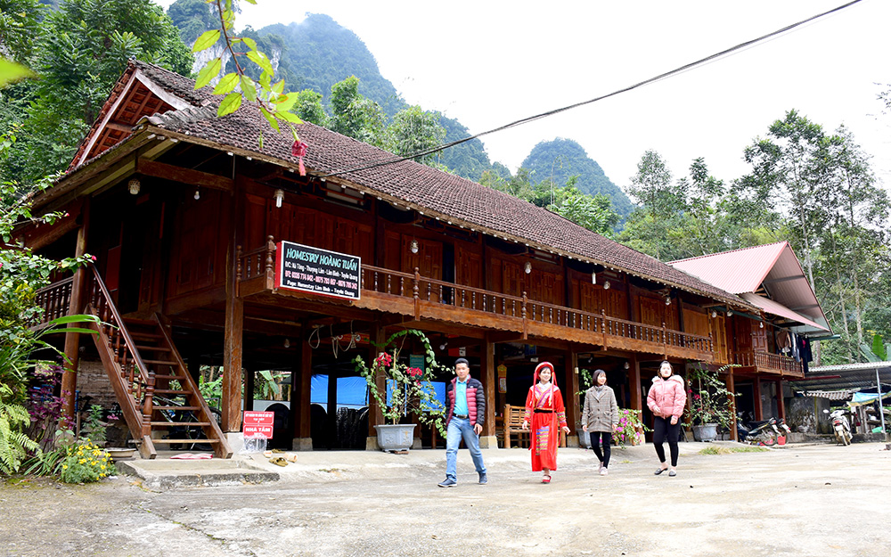
Lodging Services
Lang Can currently has 14 homestay businesses, offering traditional stilt houses and rustic accommodations. Features include handmade décor and basic amenities crafted by locals. While these provide cultural immersion, gaps exist in service quality, such as inconsistent Wi-Fi, lack of on-site dining, and limited professional training for hosts
Current State of Homestay Services

Slide 5
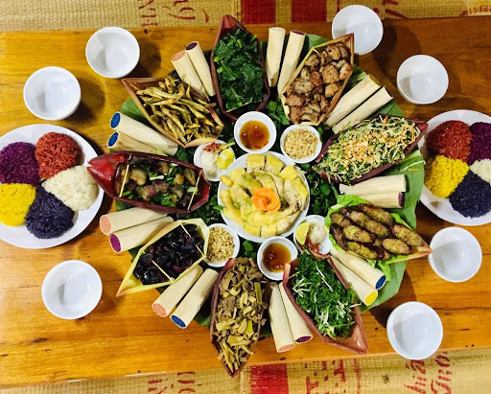
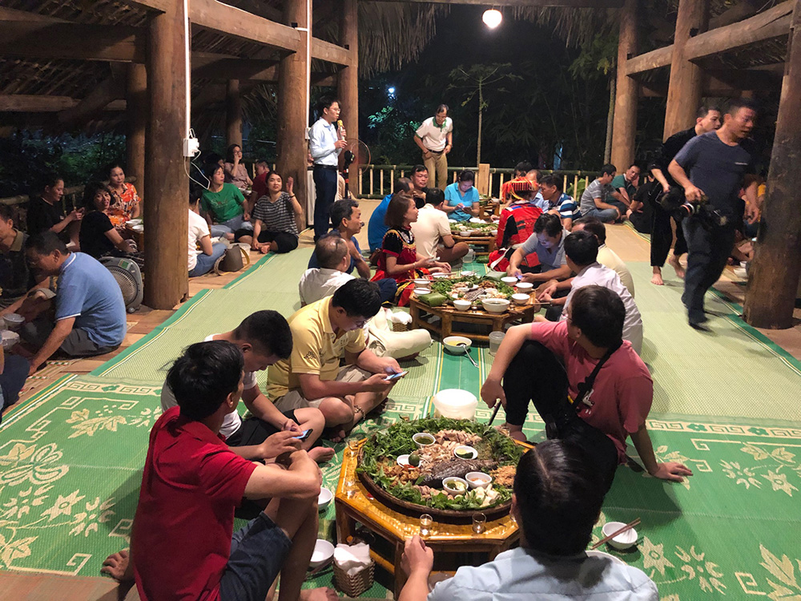
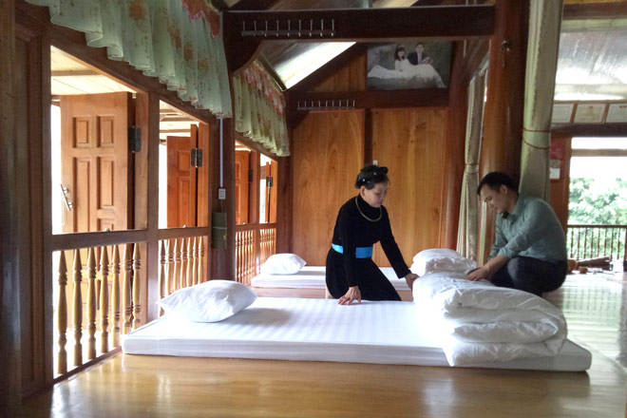
Dining Experiences
Visitors enjoy local delicacies like sticky rice, bamboo-cooked dishes, and mountain vegetables. Meals are safe and delicious, but presentation and variety need improvement to enhance appeal. Pricing is competitive, with meal packages ranging from 150,000–200,000 VND per person or 1,500,000–1,600,000 VND for larger groups. However, snack and souvenir offerings remain underdeveloped
Current State of Homestay Services

Slide 6
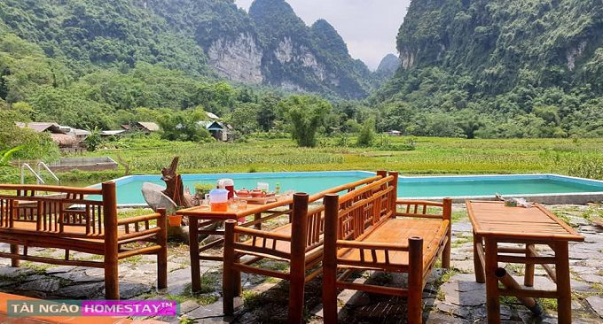
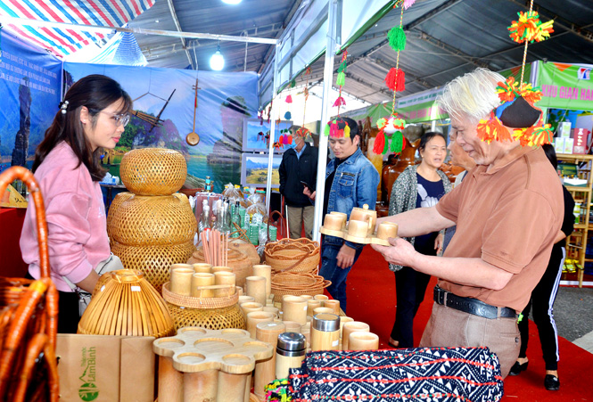
Supplementary Services
Additional activities include nature exploration, traditional craft demonstrations, and cultural performances. However, limited financial resources and lack of innovative packages hinder their ability to retain visitors for extended stays. Homestays often lack unique offerings, reducing their competitive edge
Current State of Homestay Services

Slide 7
Proposed Solutions for Enhancing Homestay Quality
Human Resource Development
Training Programs: Conduct specialized training for hosts in customer service, financial management, and cultural storytelling.
Cultural Awareness: Develop workshops emphasizing the value of local traditions and how to present them authentically to tourists.
Institutional Partnerships: Collaborate with universities and training centers to offer tourism-related courses and internships.

Slide 8
Proposed Solutions for Enhancing Homestay Quality
Facility Improvements
Infrastructure Upgrades: Ensure consistent electricity, clean water, and modern amenities such as Wi-Fi and air conditioning.
Eco-friendly Designs: Use sustainable materials and integrate traditional architectural elements to maintain authenticity.
Safety Enhancements: Install security systems and provide fire safety measures to reassure visitors.

Slide 9
Proposed Solutions for Enhancing Homestay Quality
Service Diversification
Themed Packages: Create unique experiences such as ethnic cultural tours, agricultural activities, or festival participation.
Interactive Activities: Enable guests to join daily routines like farming, fishing, and cooking traditional meals.
Ecotourism Development: Organize guided hikes, wildlife observation, and environmental conservation projects

Slide 10
Proposed Solutions for Enhancing Homestay Quality
Marketing and Communication
Digital Presence: Build professional websites and leverage social media to showcase homestays.
Event Participation: Join tourism fairs and organize promotional campaigns to increase visibility.
Collaborations: Partner with travel agencies and influencers to expand outreach.

Slide 11
Proposed Solutions for Enhancing Homestay Quality
Educational Initiatives
Host workshops for residents on hospitality skills, sustainable practices, and customer service.
Integrate tourism topics into school curriculums to foster early interest and understanding among younger generations
Community Collaboration
Encourage locals to contribute crafts, agricultural products, and cultural performances, enhancing the tourist experience and generating income.
Develop forums where community members can propose ideas and share feedback on tourism development plans

Slide 12
Enhancing homestay services in Lang Can requires a multifaceted approach, combining human resource development, infrastructure investment, service diversification, and effective marketing. Community participation is key to preserving cultural heritage and ensuring sustainable tourism. By addressing current challenges and leveraging local strengths, Lam Bình can position itself as a premier destination for authentic and enriching travel experiences.
THANK YOU

