Slide 1
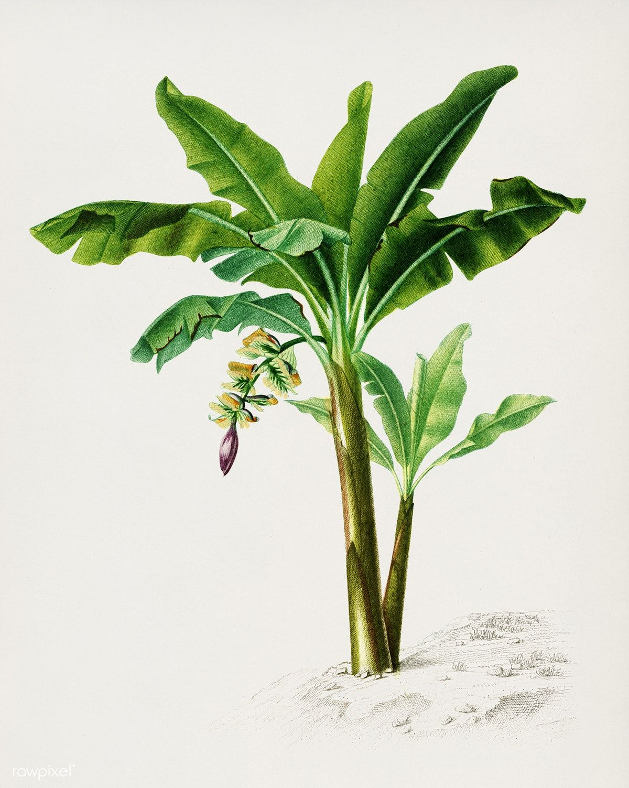
Living lab Project
The cycle of bananas in economic development in Tuyen Quang Province
Course: Macro-Economics Instructor: Hoàng Anh Đào (Group 1) | Phạm Ngọc Anh Cao Ngọc Ánh La Thanh Bình Nguyễn Thùy Dung Ngô Phúc Hậu (Leader) Trần Thị Huyền (Presenter) Lê Khánh Linh Đặng Thuỷ Mai

Slide 2
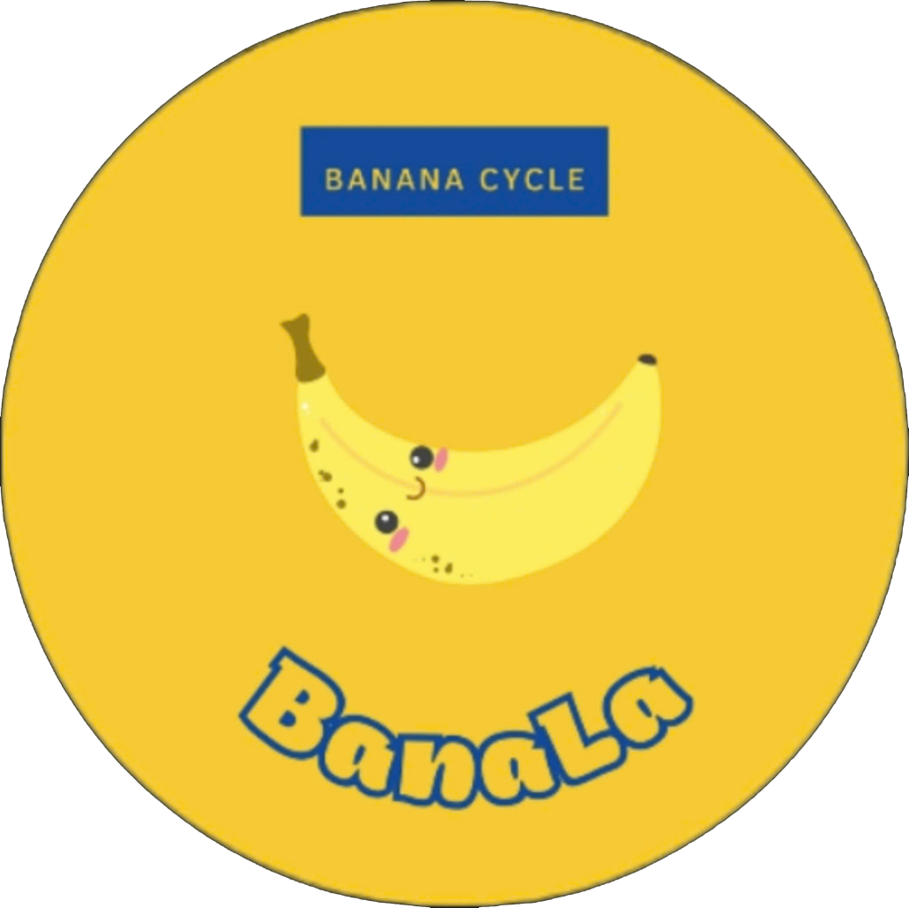
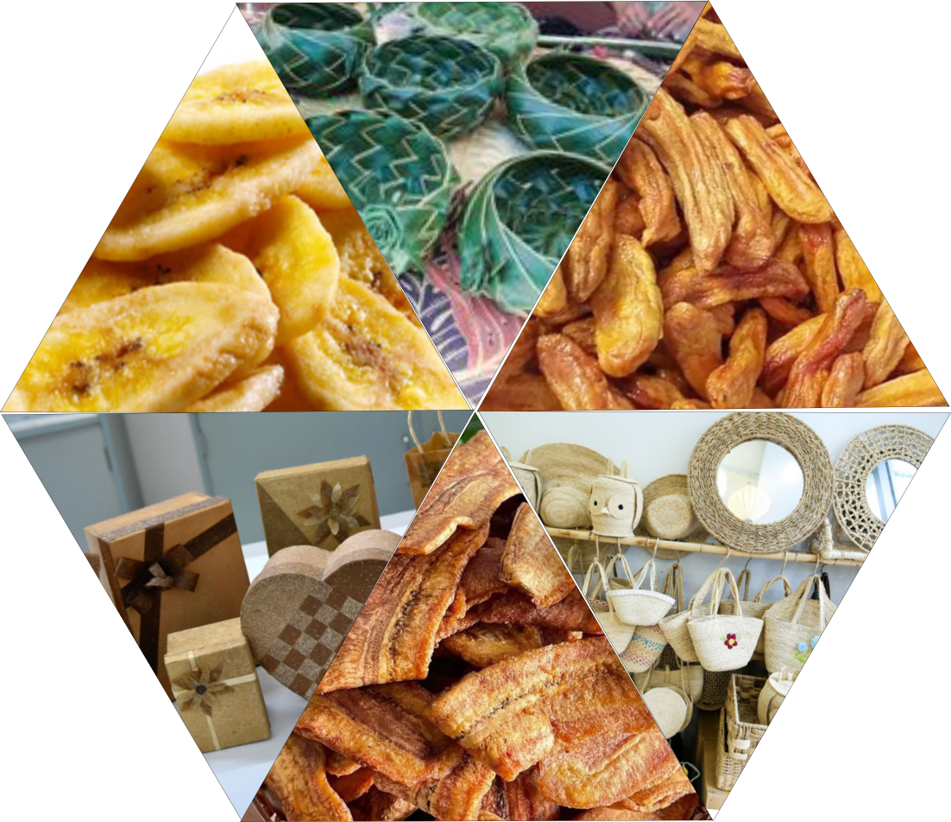
The core idea of the project:
Maximizing the use of raw materials, specifically the unsellable parts of banana tree
→ production and processing
→ significantly increasing the product's value many times over
-> developing the local economy.

Slide 3
NECESSITY OF THE LIVING LAB PROJECT
In 2024, the estimated banana production is approximately 100,880 tons, with Yen Sơn district, Tuyen Quang province expected to produce 10,000 to 20,000 tons, covering a planting area of over 1,400 hectares. The large banana production area drives a high demand for fertilizers, with local farmers primarily relying on chemical fertilizers for their crops.
Banana products are mainly sold as fresh fruit at very low prices, averaging 2,000 – 3,000 VND/kg, meeting the following criteria: a bunch with at least five full hands of bananas, still green, without scratches, and discarding the last hand of the bunch. Only 70% of bananas meet these criteria and are marketable, while the remaining 30% (estimated at 3,000 tons/year in Tuyen Quang) are rejected. This excludes other parts of the banana plant. Additionally, banana plants grow rapidly, continuously sprouting new offshoots, which farmers often cut and discard to thin out the banana clumps, ensuring the quality and quantity of the banana bunches. Other parts of the banana plant, such as discarded roots, unmarketable bunches, discarded last hands of the bunches, banana stems, banana sheath, banana leaf stalks, and old banana leaves, are often thrown into waste piles, streams, or rivers, leading to significant waste and environmental pollution.

Slide 4
NECESSITY OF THE LIVING LAB PROJECT
Banana Plantations: Establishing partnerships with banana farms where the project purchases the byproducts from banana plants that are typically discarded to use as raw materials. Additionally, collaborating with farms to grow pennywort under banana canopies to utilize the shaded areas. The harvested pennywort will be cold-dried into powder or dried for tea production. This initiative can be expanded to develop more pennywort-based products, maximizing the use of shaded areas.
Raw Materials: Including rejected bananas, last hands of banana bunches, banana stems, leaf stalks, other discarded parts of banana bunches, banana roots, and pennywort (low cost, as they are currently being discarded by farmers).
Production: Processing and producing various products from banana plants to increase the value of the materials:
Bananas: Banana chips, banana cakes, dried bananas, banana wine, banana jam, etc.
Banana Roots: Banana root powder.
Banana Stems and Leaf Stalks: Banana fibers and leaf stalks to produce souvenirs, handbags, and baskets.
Banana Peels and Processing Waste: Leftovers from banana processing and unused plant parts are collected, crushed, and processed into organic fertilizer, which is returned to the farms to support banana cultivation and care.
Sales: Selling processed products to generate revenue, enhance product value, and bring profits to the project.

Slide 5
CORE SOLUTIONS
CULTURAL
Traditional dishes or trendy youth products.
Souvenirs or daily-use products.
Increasing income for workers and banana farmers in the local area.
01
04
02
ECONOMIC
HEALTHY
Methods to diversify products, maximizing the use of banana-derived products; protecting ecosystems.
Foods that support weight loss, providing abundant vitamins and minerals for the body.
Handcrafted products without toxic substances, ensuring the health of users.
03
ENVIRONMENTAL

Slide 6
UNIQUENESS AND CREATIVITY OF THE LIVING LAB PROJECT
Flexibly applying a circular economy model to banana plants, creating a closed-loop value chain from farming → production → recycling → returning to farms. This is a model for sustainable economic development.
Raw materials are derived from discarded banana byproducts, which are low-cost and available in large quantities.
The model transforms "waste" into "high-value economic products," ensuring high profit margins, minimal investment, and quick capital recovery.
Maximizing resource utilization by fostering economic development in local areas using indigenous resources.
Processing banana-based products increases the value of agricultural produce many times over. The products have short life cycles, rapid purchase and repurchase rates, and a vast market potential.
Satisfies Gen Z consumer demands for products that are delicious, affordable, convenient, fast, natural, healthy, and environmentally friendly. This group represents a highly potential market segment with a high repurchase rate.
Minimizes waste discharged into the environment, promotes sustainable agricultural practices, and protects the environment.

Slide 7
EXPECTED BENEFITS OF THE LIVING LAB PROJECT
Flexibly implementing the circular economy model in the production and business of banana-based products. Shifting agricultural practices from dependency on chemical fertilizers to the proactive use of organic fertilizers, thereby forming sustainable and eco-friendly farming ecosystems.
Fully utilizing local resources and agricultural byproducts, turning "waste" into "high-value economic products," increasing the value of bananas and boosting profits. Creates job opportunities for many local workers.
Enriching the lives of individuals, families, and communities, particularly benefiting ethnic minority groups in mountainous areas that face significant challenges.

Slide 8
BUSINESS MODEL
Key Partners | Key Activities | Value Propositions | Customer Relationships | Customer Segments
- Distributors, retail chains, convenience stores. | - Collaborate with farms to purchase raw materials → produce and process raw materials → create finished products (bananas and byproducts). | - Convert banana byproducts into high-value products. | - Product introduction programs. | - Youth (Gen Z) is the primary target customer.
- Banana farms: planting, supplying, checking, and maintaining quality. | - Establish production models based on raw material areas to complete a closed production chain. | - Create a circular economy for the banana tree. | - Affiliate programs. | - Aged 15-25, diverse gender groups, with interests in health, beauty, and trendy products.
- Agricultural research institutions. | - Sell products. | - Focus on quality, durability, convenience, and environmental friendliness, meeting customers' needs for sustainable products. | - Promotions, customer interaction, and engagement. | - Younger demographics prefer purchasing through online platforms like TikTok, Facebook, Shopee, Lazada, and others.

Slide 9
BUSINESS MODEL
Key Resources | Cost Structure | Revenue
- Raw materials: banana byproducts, available at low cost. - Raw material regions. - Labor resources: active, hardworking. | - Raw materials. - Labor costs, management costs. - Logistics: branding, packaging, logo, taxes. | - Selling finished products. - Selling organic fertilizers.

Slide 10
Strengths
- Large raw material areas, affordable raw materials derived from banana byproducts.
- Local labor force: skilled, affordable, and readily available.
- Products are diverse, meet safety standards, and cater to the needs of target customers.
- Focus on Gen Z: understanding youthful preferences and leveraging modern platforms like e-commerce.
- Competitive pricing.
Weaknesses
- Constantly changing trends make it challenging to keep up with the preferences of young customers.
- Banana-based products are limited in variety, which may reduce market reach.
- Limited experience in marketing and customer engagement.
Opportunities
A young target audience willing to spend and make quick purchase decisions.
- Customers’ preference for sustainable, eco-friendly products aligns with current global trends.
- Products for short-term use are highly appealing to modern consumers.
- Gen Z is a significant group driving modern retail and e-commerce, offering immense potential.
Threats
- Intense competition with existing fast-consumption products on the market.
- Incomplete customer service systems.
- Risk of falling behind customer demands and rapidly changing trends.

Slide 11
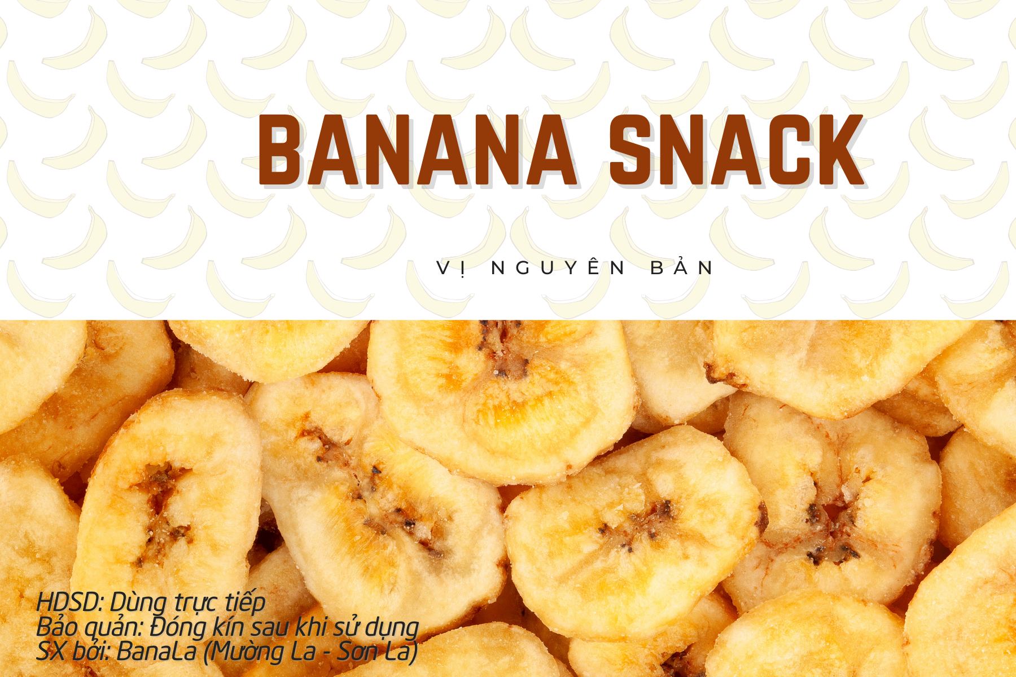
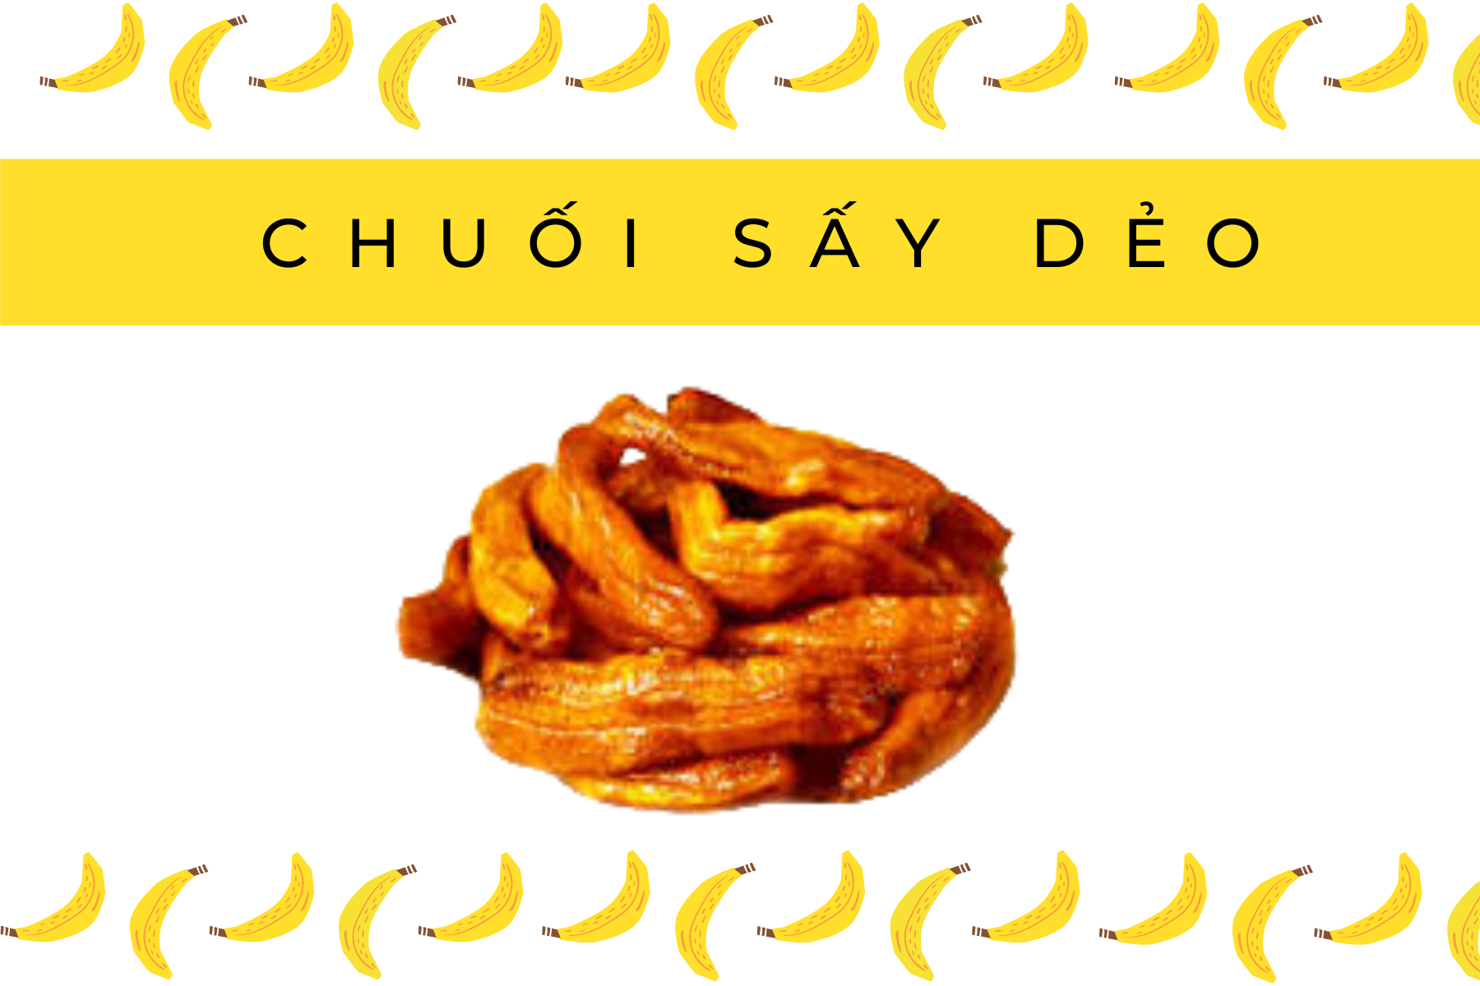
BUSINESS AND PRODUCTION PLAN
The products are divided into four categories as follows:
(1) Snack Products from Bananas
Fast-Consumption Product Group: Banana jam, banana chips, banana syrup, chewy dried bananas, etc.
Raw Materials: Bananas with imperfect appearances (blemished skins), the last hand of the bunch with smaller bananas, and bananas that are difficult to sell fresh.

Slide 12
BUSINESS AND PRODUCTION PLAN
The products are divided into four categories as follows:
(2) Banana honey
Main Ingredients: Extracts from fresh bananas and sap from banana stems.
Uses: Serves as a substitute for cane sugar. This is a natural sweetener with a pleasant banana aroma and taste. It is especially recommended by nutritionists and doctors as suitable for individuals with diabetes.

Slide 13
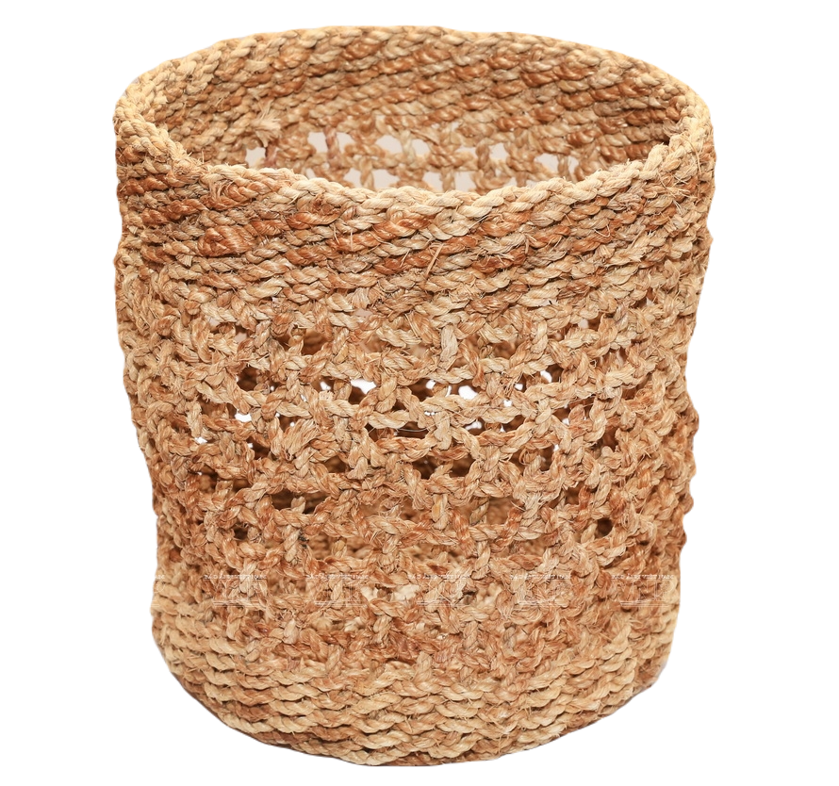
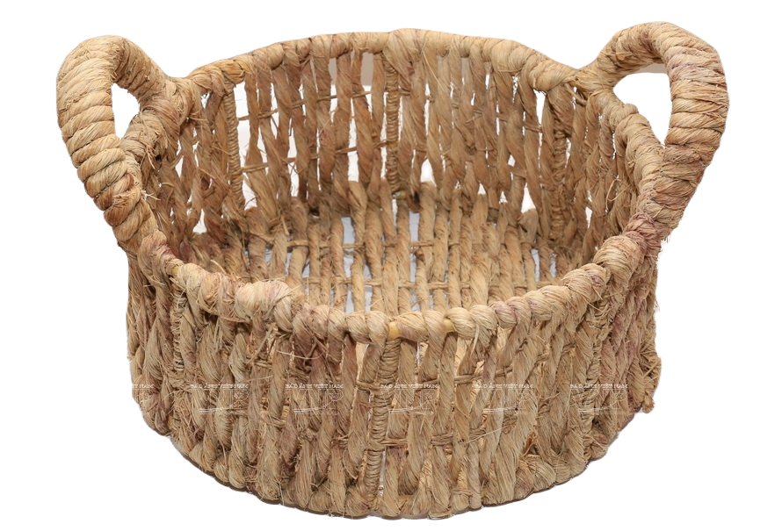
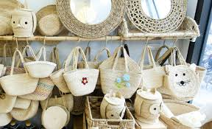
BUSINESS AND PRODUCTION PLAN
The products are divided into four categories as follows:
(3) UTILITY ITEMS AND SOUVENIRS
Main Ingredients: Products made from banana fibers and banana leaf stalks (fibers from the stem and branches of the banana plant).
Uses: Handcrafted items such as baskets, trays, handbags, storage baskets, etc., made from banana plant materials. These products are eco-friendly, reduce waste, and help protect the environment.

Slide 14
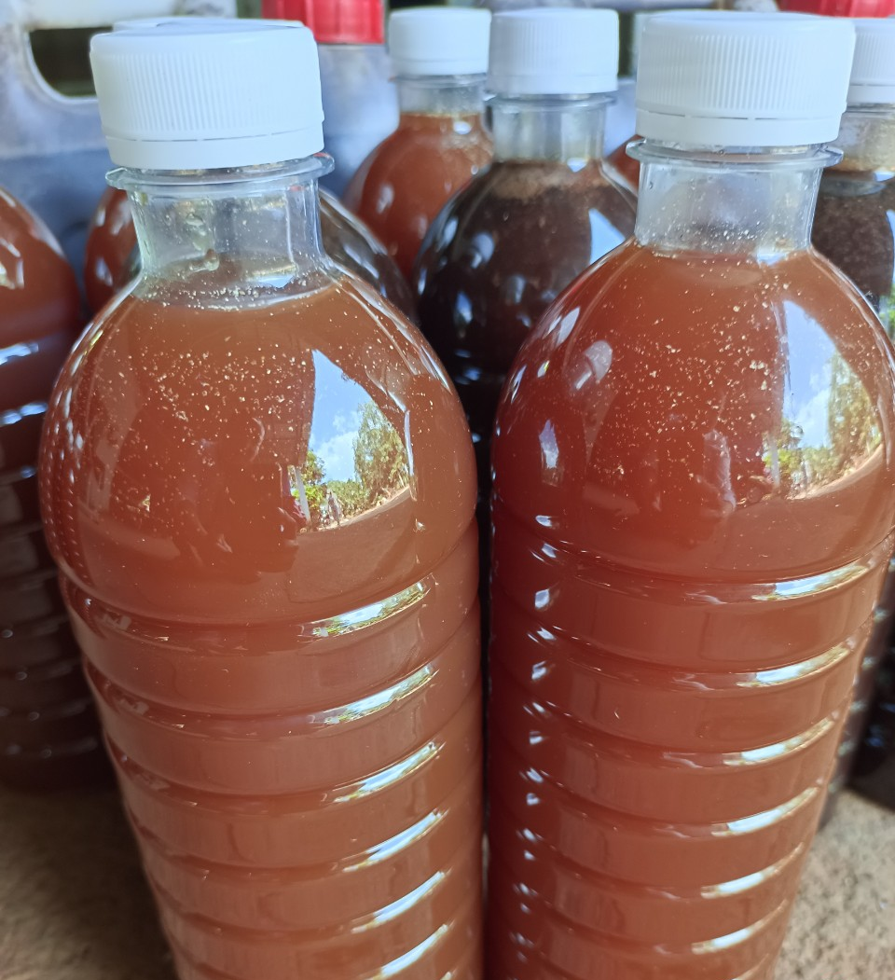
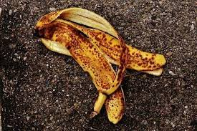
BUSINESS AND PRODUCTION PLAN
The products are divided into four categories as follows:
(4) ORGANIC WASTE
This refers to ORGANIC FERTILIZER made from waste materials generated during the production process and other unused banana byproducts.
There are two types:
- Banana extract.
- Organic fertilizer made from bananas.

Slide 15
MARKETING
Focus on online communication: Since Gen Z customers primarily shop online, their "one-click shopping" behavior is highly promising. Enhance promotional programs and product combos on e-commerce platforms. Utilize live-stream selling to boost engagement and sales.
Social Media: TikTok, Facebook, Instagram, Zalo, and online gaming platforms.
Online sales agents.
Strengthen communication at physical locations: Promote products at snack shops near schools, cafeterias, convenience stores, park vendors, lemon tea and bubble tea shops, and supermarkets.
Proactively follow and leverage trends: Align products with trending topics to create connections and familiarity with customers.
Fast and attentive customer service: Ensure quick and thoughtful responses to increase repeat purchases.
Boost emotional marketing and experiential shopping: Implement tactical campaigns that encourage customers to purchase through emotional connections. Organize workshops for interactions, check-ins, and sharing experiences.

