Slide 1
Living lab Project
THE IMPACT OF SOCIAL MEDIA ON THE SHOPPING BEHAVIOR OF YOUTH IN THE URBAN AREA OF TUYÊN QUANG CITY
By Group 1- Macroeconomics

Slide 2
Members
Name | Task
Đoàn Khánh Linh | Member
Lê Thị Hồng Hải | Leader
Quan Thị Thuỷ | Presenter
Nguyễn Thị Thu Trang | Member
Phoumek Vorphaxai | Member
Trần Quang Trung | Member

Slide 3
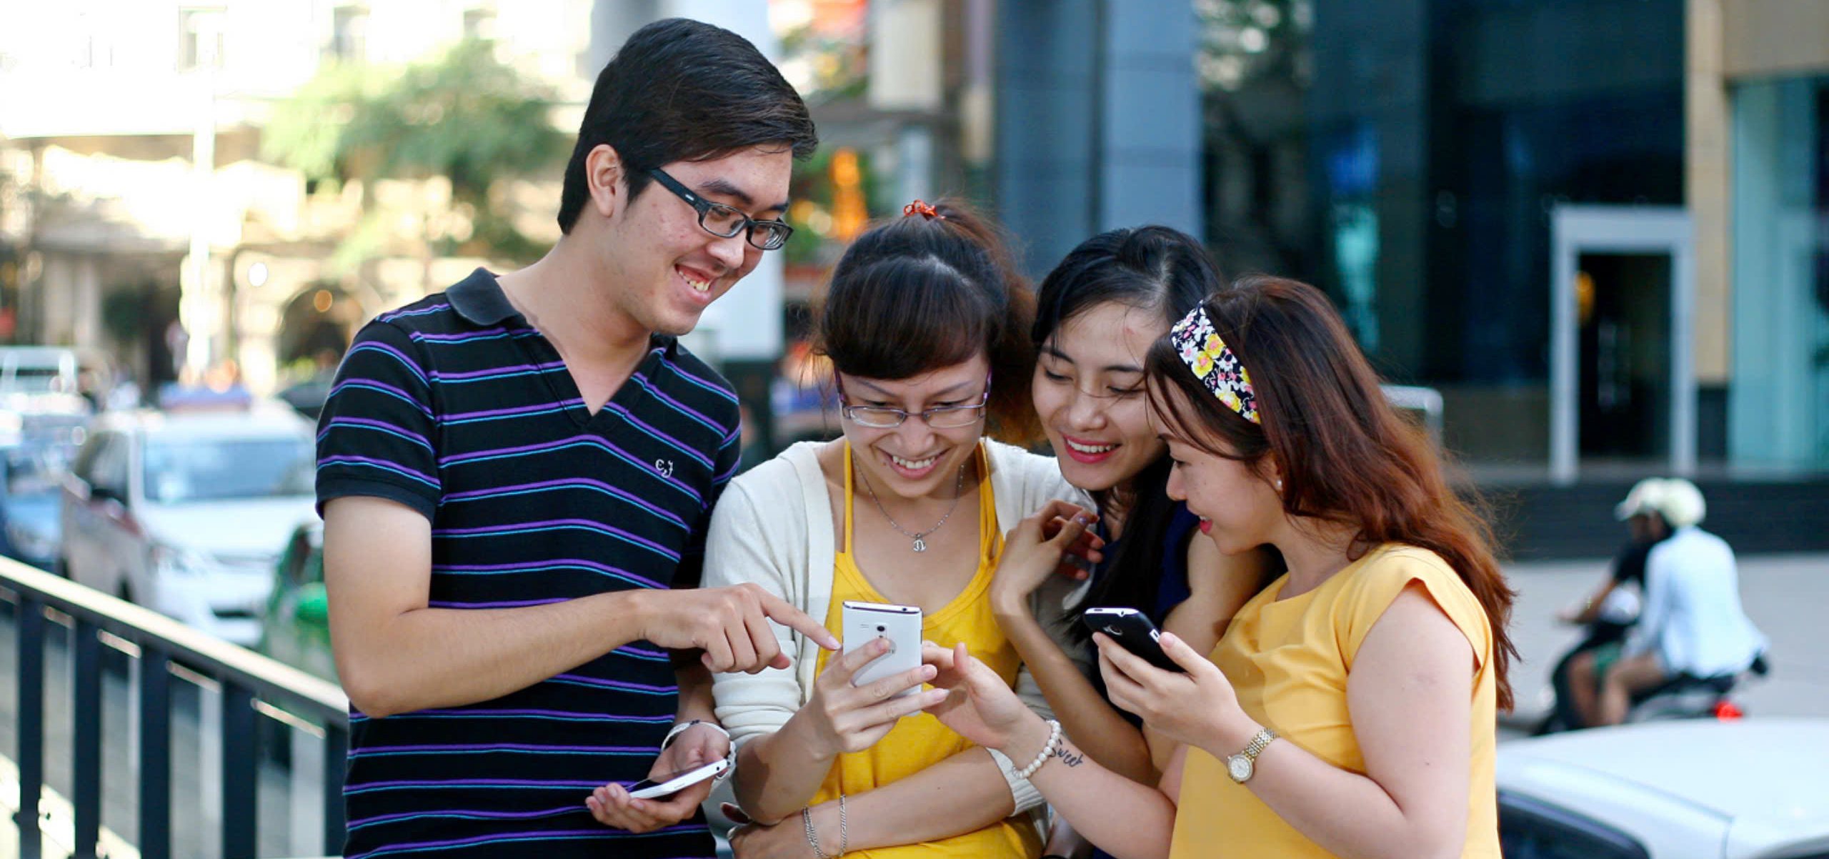
INTRODUCTION
In the modern context, social media has become an indispensable part of young people's lives. With the rapid growth of platforms such as Facebook, Instagram, TikTok, and YouTube, the consumption habits of the youth are increasingly influenced by online content, trends, and advertising campaigns. The shopping behavior of young people is not only shaped by direct advertisements but also by posts from celebrities, influencers, and product reviews from online communities. This impact extends beyond major cities and has begun to reach mountainous regions, where young people are gradually gaining access to technology and social media.
Online shopping has brought about a significant shift in the consumption habits of people in these areas. However, the question arises: To what extent does social media influence the shopping behavior of young people in Tuyên Quang City? And does this change in consumer behavior contribute positively or negatively to the economic development of these regions?

Slide 4
I
Concepts
The behavior and psychology of young people in Tuyen Quang City when using social networks
II
CONTENTS
Optimal Solutions to Maximize the Impact of Social Media on the Shopping Behavior of Youth in Tuyen Quang City
III

Slide 5
CONCEPTS
Social Network refers to a structure or platform that facilitates connections and interactions among individuals, organizations, or entities, allowing them to share information, ideas, and resources. In the context of digital technology, a social network typically describes online platforms (such as Facebook, Instagram, LinkedIn, Twitter, etc.) that enable users to communicate, engage, and build relationships through features like messaging, posting content, commenting, and following other users.
Social networks serve various purposes, including personal communication, professional networking, entertainment, and marketing, and play a significant role in shaping social interactions and cultural trends in modern society.

Slide 6
FEATURES OF SOCIAL MEDIA
SOCIAL
Network Attribute
Connections and relationships
Interactivity
Online interactions Virtual and real-world interactions
Identity and uniqueness Privacy and data protection Personalized algorithms
Personalization
Connectivity
Expanding the social relationship network
Viral Nature
Information, ideas, and content shared and spread quickly

Slide 7
CONSUMER PURCHASING BEHAVIOR
Consumer Purchasing Behavior refers to the study of how individuals or groups make decisions to buy, use, and dispose of goods and services to satisfy their needs and desires. This concept encompasses the psychological, social, cultural, and economic factors that influence a consumer's decision-making process.
It typically includes four key stages:
Need Recognition: Identifying a need or problem that requires a solution.
Information Search: Researching products or services that can fulfill the need.
Evaluation of Alternatives: Comparing different options based on factors like price, quality, and reviews.
Purchase Decision and Post-Purchase Behavior: Making the purchase and assessing satisfaction or dissatisfaction with the product or service.

Slide 8
CHARACTERISTICS OF CONSUMER
PURCHASING BEHAVIOR
SOCIAL
Need Recognition
Physiological, safety, social, esteem, and self-actualization needs are identified.
Information Search.
Searching for information from various sources.
Evaluation of Alternatives
Choosing the most suitable product or service.
Purchase Decision
Influenced by personal and external environmental factors.
Post-Purchase Evaluation
Assessing product quality to determine if it meets customer expectations.

Slide 9
Positive
Mechanisms through which social network influences purchasing behavior: targeted advertising; influencer marketing; content and viral marketing; social proof and user-generated content (UGC).
1
Psychological and consumer behavior factors: group effect; brand perception; brand loyalty; FOMO (Fear of Missing Out) effect; two-way interaction.
Impacts of social networks on purchasing behaviors
Shopping experience on social network: integrated shopping, direct interaction through social network.
Social, psychological, and financial pressures.
The phenomenon of social comparison and trend-chasing.
Negative
Excessive and exaggerated advertising and marketing
2
Misinformation and high risk of fraud

Slide 10
I
The current state of social media usage among the youth in Tuyên Quang City
How will the behavior and psychology of young people change when participating in the online shopping market?
II
Behavior and Psychology of Youth in Tuyên Quang City When Using Social Network
Factors influencing the behavior and psychology of the youth when engaging in online shopping channels.
III
The advantages and impact of online shopping for the youth—how does it affect the economy in Tuyên Quang Province?
IV
V
Limitations and challenges that still exist when accessing online shopping.

Slide 11
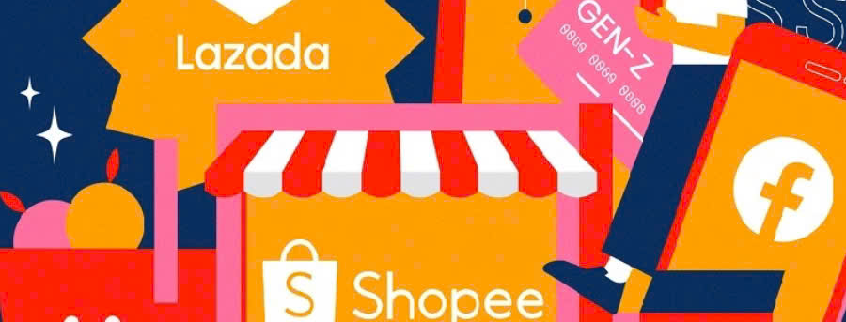
THE CURRENT STATE OF USING SOCIAL NETWORK
AMONG YOUTH IN TUYÊN QUANG CITY
YOUNG PEOPLE
Overview of Youth Demographics:
The youth population aged 15-30 accounts for approximately 25% of the total population of Tuyên Quang City, equivalent to about 130,000-150,000 people. The education level is relatively high, with a high school graduation rate of about 85-90%. Among them, a significant proportion continues to higher education programs, colleges, or vocational schools. The internet access rate in Tuyên Quang City is over 85%, with social media usage being highly prevalent.
Social Media Usage Among Youth in Tuyên Quang City: 90% of children aged 13 to 17 use social media platforms. 75% have at least one personal social media account. 51% use social media daily, and two-thirds have mobile devices connected to the internet. The amount of time spent on social media varies: 1-3 hours (35%); 3-5 hours (25.7%); >5 hours (22.6%); Less than 1 hour (16%).
FACEBOOK
(90%)
Searching for products, connecting with others.
INSTAGRAM
(40-50%)
Following trends, connecting personally.
ZALO
(70-80%)
Connecting, purchasing local products.
Popular Social Media Platforms and Their Uses
TIK TOK
(60-70%)
Exploring videos, receiving product advertisements.
YOUTUBE
(80%)
Watching product reviews and tutorials.
E-commerce platforms integrated with social media
(40-50%)
Searching for product information, conducting transactions.

Slide 12
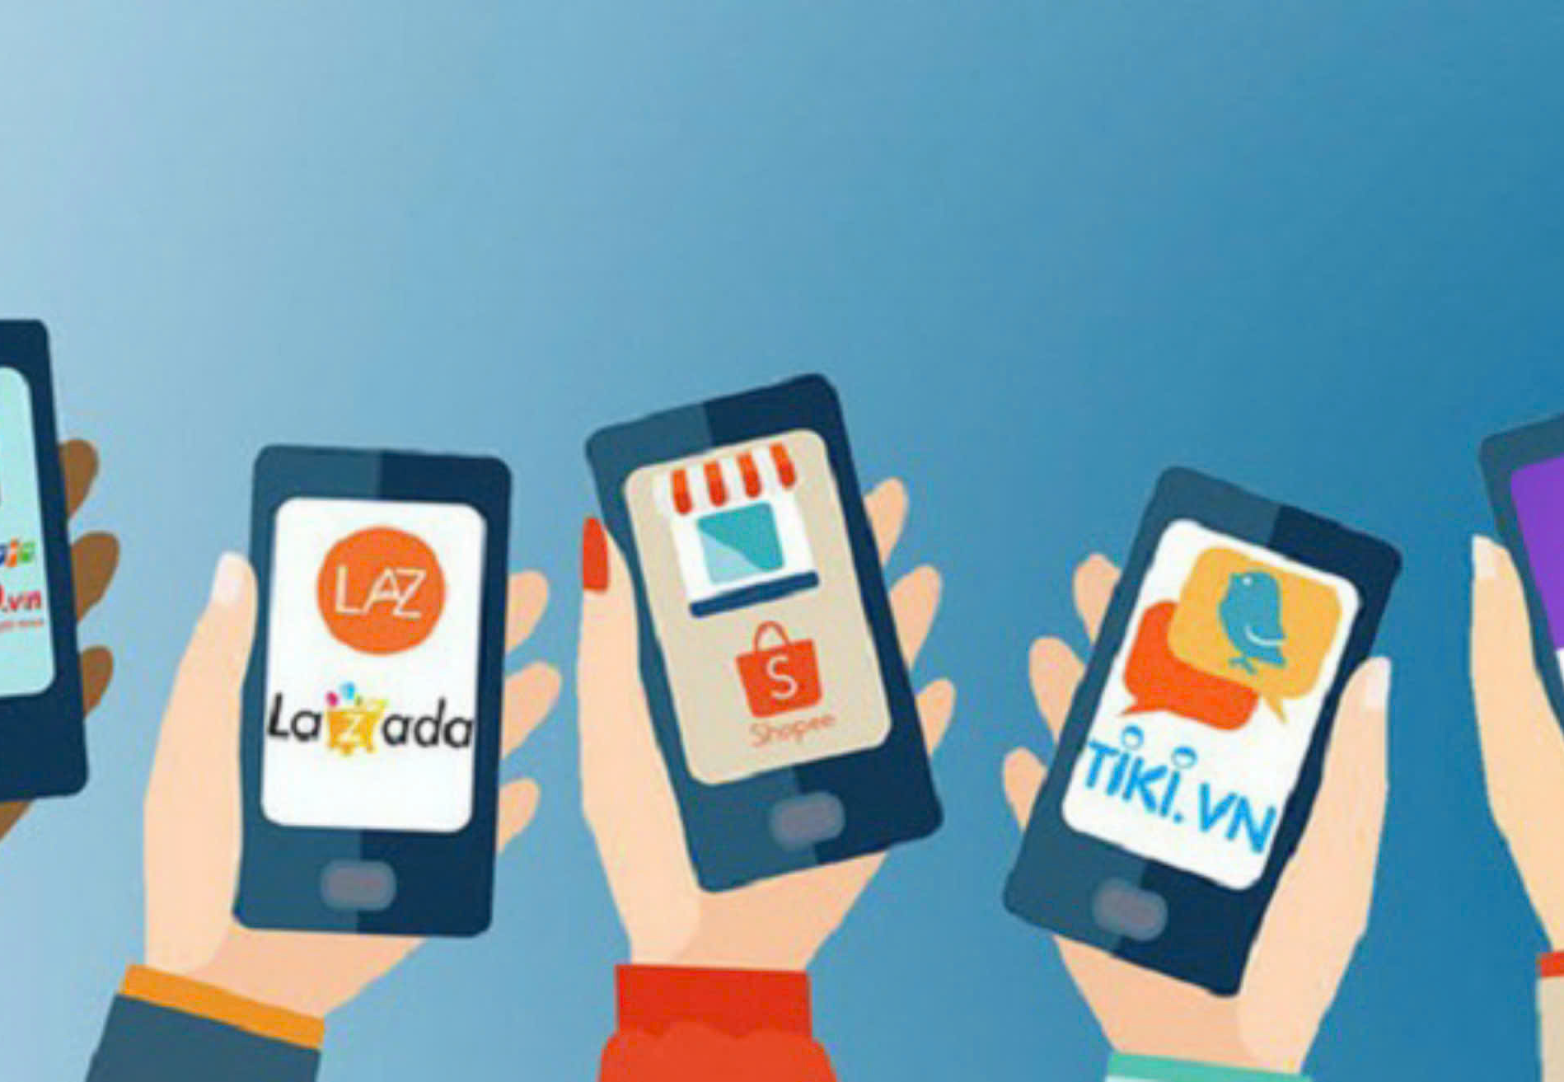
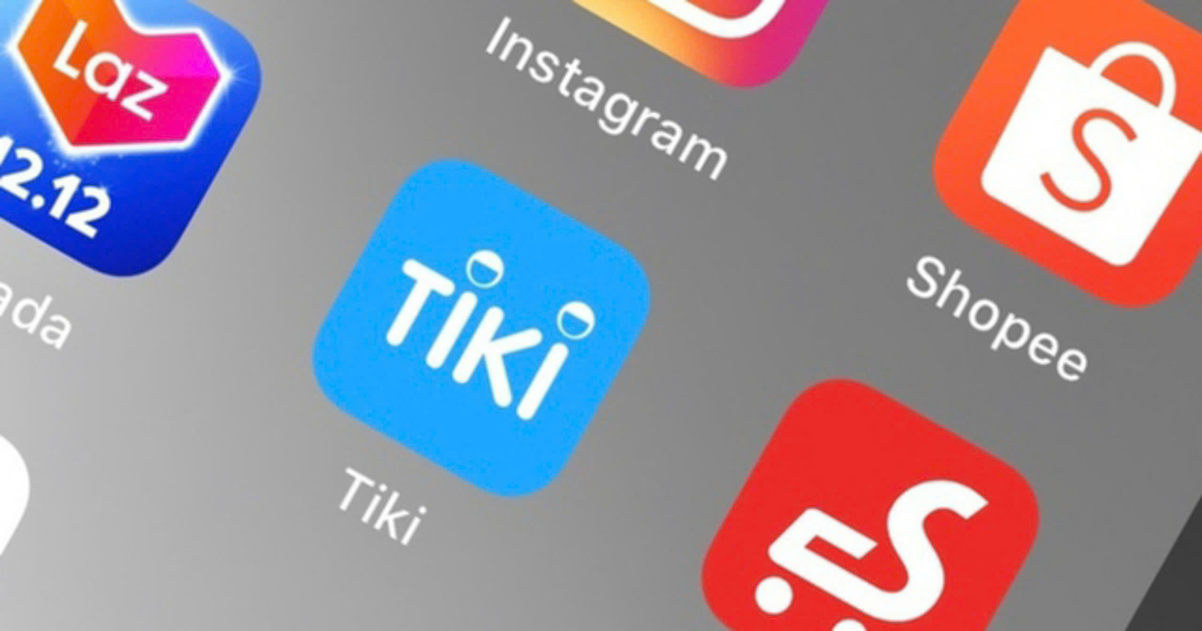
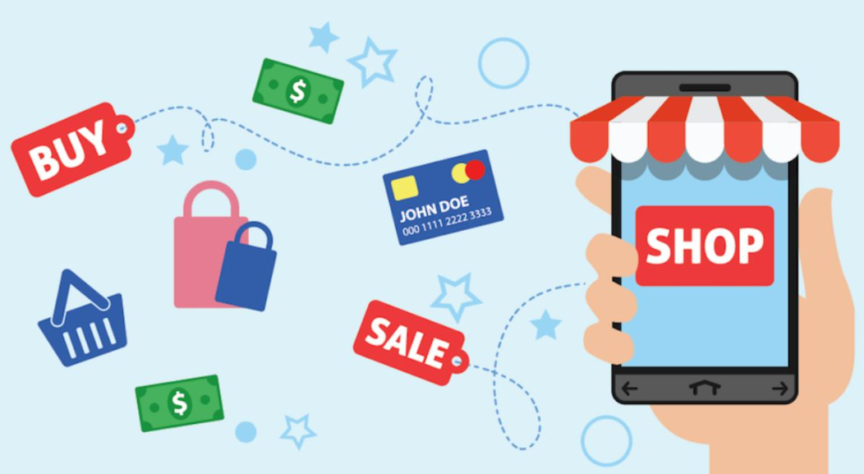
1
Comfort and Convenience
2
Psychology of Hunting Sales and Promotions
3
Comparison and Reference
4
Utilizing Multi-Channel Platforms
HOW WILL THE BEHAVIOR AND PSYCHOLOGY OF YOUNG PEOPLE CHANGE WHEN PARTICIPATING IN ONLINE SHOPPING CHANNELS?
5
Expectation of Speed
6
Influence of "Social Proof"
7
Emotional Spending
8
Personalization and Experience
9
Safety and Security

Slide 13
1. Behavioral Changes
Increased Impulsivity: Tendency to make quick purchasing decisions influenced by flash sales, discounts, and limited-time offers.
Preference for Convenience: Favoring online shopping due to ease of use, home delivery, and time-saving features.
Engagement with Recommendations: Strong reliance on influencer endorsements, product reviews, and personalized suggestions.
2. Psychological Effects
Trust Development: Gradually building trust in online platforms through positive experiences and secure transactions.
Social Comparison: Comparing purchases and lifestyles with peers and influencers, leading to a desire to keep up with trends.
FOMO Effect: Fear of missing out on popular or trending products promoted online.
3.Emotional Responses
Satisfaction and Excitement: Positive emotions associated with successful purchases and receiving products.
Buyer’s Regret: Potential feelings of regret or dissatisfaction if products fail to meet expectations or due to impulsive buying.
4. Digital Dependence: Increasing reliance on online shopping for daily needs, potentially reducing visits to physical stores.
HOW WILL THE BEHAVIOR AND PSYCHOLOGY OF YOUNG PEOPLE CHANGE WHEN PARTICIPATING IN ONLINE SHOPPING CHANNELS?

Slide 14
OBJECTIVE FACTORS
Technology and shopping platforms
Brand reputation and seller credibility
FACTORS AFFECTING THE PSYCHOLOGY AND BEHAVIOR OF YOUTH IN ONLINE SHOPPING
Promotion and discount policies
Customer service and after-sales support
YOUNG PEOPLE
SUBJECTIVE FACTORS
Personal preferences
Income and financial capability
Desire for new experiences

Slide 15
IMPACTS OF YOUTH ONLINE SHOPPING ON THE ECONOMY OF TUYÊN QUANG PROVINCE
CITY
Growth of Online Platforms
65% of young people aged 18-30 in Tuyên Quang have shopped through online platforms, driving a significant shift in consumer behavior.
Growth of national E-commerce
Tuyen Quang contributes to Vietnam's growing e-commerce market, with an average annual growth rate of around 20%.
Development of Logistics and Transportation
Viettel Post and Giao Hàng Nhanh account for 50% of deliveries in Tuyên Quang, with annual growth rates of 30%-40% from 2021 to 2022.
Transformation in the Retail Sector
Approximately 15% of retail stores in Tuyên Quang have started offering online sales channels.
Job Creation and Startup Development
The number of startups entering the e-commerce sector grows by around 25% annually.
E-commerce Revenue
According to forecasts, the e-commerce revenue in Tuyên Quang is expected to reach 500-600 billion VND by 2024.

Slide 16
SOLUTIONS
PROS AND CONS
Enhancing awareness of smart consumption on social media.
Solution | Advantages | Challenges
1 | Rapid access to technology. | Lack of experience and knowledge.
 | A potential market for young consumers. | High risk of fraud.
 | Ability to utilize social media and marketing.
2 | Opportunities for financial education. | Difficulty in content monitoring and control.
 | Development of technological skills. | Lack of knowledge about cybersecurity.
3 | Supportive policies from the government. | Unequal internet access in underdeveloped areas.
 | Raising awareness about digital literacy. | Limited logistics and delivery infrastructure in some regions.
 | Trends toward the growth of social media platforms.
Solutions for Young People When Participating in the Online Marketplace
1
Developing personal financial management skills.
Improving the ability to understand and evaluate product information.
Solutions for Parents to Support and Educate Children When Participating in the Online Marketplace
Educating children on real-world values and needs.
Guiding them to use social media safely.
2
Assisting children in managing their finances effectively.
Improving communication and internet infrastructure.
Upgrading transportation and logistics systems
Solutions for provincial government in Participating in the Online Marketplace
3
Strengthening cooperation with local businesses.
Promoting electronic payments and digital services.

Slide 17
CONCLUSION
It is evident that the formation and development of online shopping are closely tied to economic, political, social, and technological trends, making it an objective trend that aligns with the principles of development. Online shopping has emerged and flourished globally thanks to key foundations: the trend of economic globalization, the development of the knowledge economy, the digitization of socio-economic activities, and the remarkable advancement of information technology, especially with the advent of the Internet, Web, and smartphones.
The explosion of the internet and social media in recent years has fueled the rapid growth of online shopping, making it a primary consumer trend in the future. Advertising through social media today is highly convenient, simple, and cost-effective for all segments, from small individual businesses to large enterprises.
The growth of shopping behavior through social media offers opportunities for buyers to access products more easily. However, it also presents challenges related to digital literacy and technological understanding.

Slide 18
THANK YOU
FOR YOUR WATCHING!

