Slide 1
LIVING LAB PROJECT:
APPLICATION OF THE “LOCAL TOURMATE” APP IN TOURISM DEVELOPMENT
IN TUYEN QUANG PROVINCE
Course: Tourism Economics Instructor: Hoàng Anh Đào | Class: Tourism K7 Semester: Autumn 2024
No. | Name
1 | Ứng Quỳnh Anh | Leader
2 | Lý Thị Giả | Presenter
3 | Phùng Hoàng Hải | Member
4 | Nguyễn Công Minh | Member
5 | Sùng A Mình | Member
6 | Bùi Hồng Ngọc | Member
7 | Cao Thị Như Quỳnh | Member
8 | Nhữ Khắc Kiên | Presenter

Slide 2
I. PROJECT SUMMARY
Objectives
Enhance community participation in tourism development.
Scope
Pilot implementation at several key tourist attractions in Tuyen Quang, including historical sites, scenic locations, and cultural villages
Participants
Primary Participants: Domestic and international tourists. Local residents (tour guides, artisans, service providers).
Apply technology to improve tourism experiences and promote the cultural and historical values of Tuyen Quang.
Foster collaboration among stakeholders (government, businesses, communities, and tourists)
Collaborative Participants: Tuyen Quang Department of Culture, Sports, and Tourism; Universities (students and lecturers specializing in tourism research); Tourism and technology enterprises.

Slide 3
I. PROJECT SUMMARY
Core Idea
Develop the "Local TourMate" app to help tourists easily connect with local guides and find travel companions while exploring Tuyen Quang Province.
Application Description
"LocalTourMate" is an application inspired by travel experiences. With smart scanning and search features, the app enables tourists to effortlessly connect with and choose guides and travel companions, making their trips more enjoyable, convenient, and cost-effective. At the same time, it creates job opportunities for tour guides in Tuyen Quang Province.
Expected Outcomes
Quantitative Results:
80% of tourists in Tuyen Quang will use the "Local Tourmate" application.
Increase the number of tourists by 20% compared to the previous year.
Train and engage 50 local residents to provide services through the application.
Qualitative Results:
Raise community awareness about the cultural and economic value of tourism.
Improve the tourism experience in Tuyen Quang by combining technology with local elements.

Slide 4
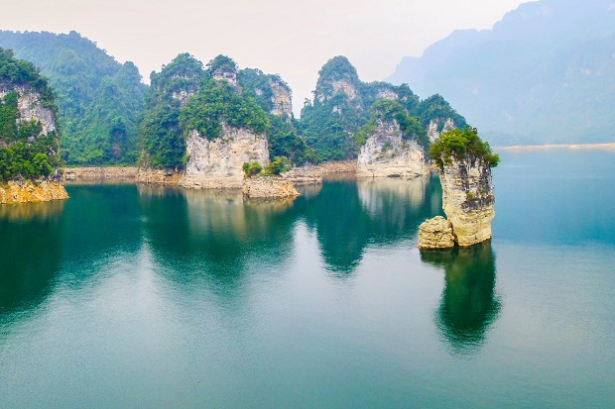
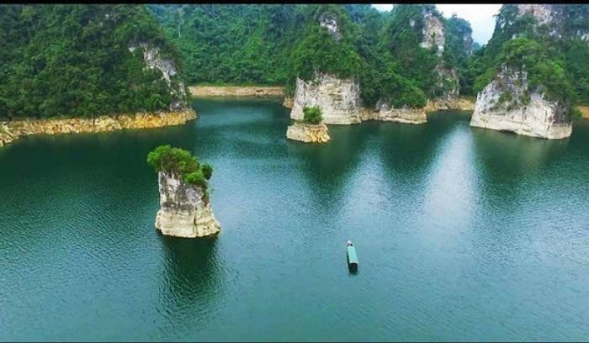
II. Necessity of the Living lab project
In the context of a rapidly growing tourism industry and the increasing popularity of personalized travel, the demand to connect tourists with unique and authentic travel experiences has become an essential aspect of modern life. Travelers today seek experiences that reflect their personal preferences, differing from traditional tours. However, finding accurate information about destinations, unique activities, and overcoming language barriers and cultural differences remain significant challenges for tourists.
Local TourMate was created to address these existing issues in the tourism industry, particularly in Tuyen Quang Province.
Provides a platform that connects tourists with flexible, customizable tours while helping them overcome difficulties in finding accurate and reliable information.
Enables tourists to gain deeper insights into the culture, customs, and lifestyle of the communities they visit, creating more authentic and meaningful travel experiences.
Focuses on reducing the rigidity of traditional tours. Tourists can now flexibly choose activities and destinations that align with their personal interests and needs, enhancing their satisfaction and overall travel experience.
Addresses language and cultural barriers, making it easier for tourists to communicate and integrate naturally and effectively with local communities.

Slide 5
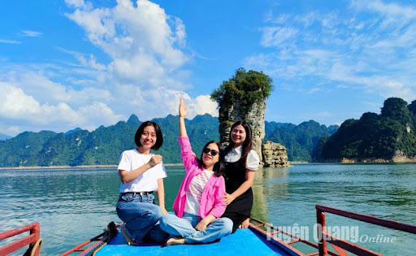
“Local Tourmate” project not only optimizes local tourism resources but also contributes to the sustainable preservation and development of cultural and historical values. It fosters sustainable tourism development, increases income, and improves the livelihoods of local communities. LocalTourMate is not just a tool to connect tourists with unique travel experiences but also a bridge that provides long-term value to both tourists and local communities, encouraging the preservation and development of indigenous cultural values. In practice, platforms like AirBnB Experiences or Withlocals have demonstrated their effectiveness in connecting travelers with local people, and Local TourMate goes further by offering instant connections and comprehensive personalization features.

Slide 6
III. Business Model Canvas
Key Partners | Key Activities | Value Propositions | Customer Relationships | Customer Segments
Tour guides Local partners. | Search and connect tourists with local guides or companions. | - Tourists can easily find reliable local guides or travel companions in Tuyen Quang through the app. - Ensure safety and reliable information from local guides. - Provide convenient, fast, and cost-effective travel solutions. | - Build strong connections with customers through social media and direct feedback. - Focus on personalized experiences via the Local TourMate platform. | - C2C (Customer-to-Customer): LocalTourMate targets individual tourists, prioritizing those who seek personalized travel experiences and connections with local expertise.
Key Resources | Channels | Cost Structure | Revenue
- Tourism resources in Tuyen Quang Province. - Network of local guides. - Resources to develop the app. | - Local partnerships to ensure user trust. - Direct promotion on platforms like Facebook, TikTok, and YouTube. | - App development costs (design, programming, testing, and deployment). - Marketing and promotion costs. | Revenue is generated from service fees, charging 30% commission on each successful connection between tourists and guides/companions. Additional revenue from collaborations with related companies.

Slide 7
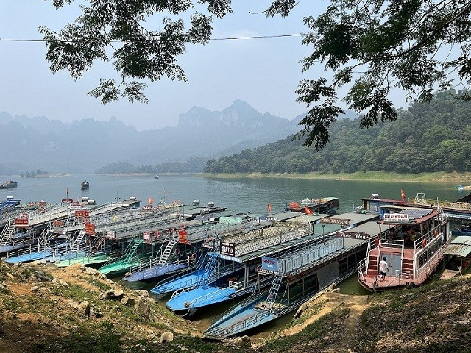
*) Feasibility:
Product Development: Based on modern technology and current online application platforms, the development of the Local TourMate app is entirely feasible. Core features such as location tracking, connectivity, and review systems are already available on existing technological platforms for implementation.
Cost Structure and Pricing: Costs will primarily focus on app development, system maintenance, and marketing campaigns. Service pricing will be calculated to align with market demand, ensuring benefits for both customers and service providers.
*) Competitiveness:
The tourism market in Tuyen Quang lacks popular travel applications. The personalized and instant connectivity features of Local TourMate are significant advantages over traditional tours and existing travel apps. The "Journeymate" feature helps create more affordable and enjoyable trips, making it a critical competitive edge.

Slide 8
On-the-Go Booking: Users can select guides or companions directly on their phones within minutes, saving time and effort.
Flexibility in Planning: If plans change, the app can quickly help users find replacements.
Platform for Freelance Guides: Independent guides or those not affiliated with large organizations have easier access to customers.
Opportunities for Local Hosts: Local residents can become travel companions, showcasing the unique cultural beauty of their hometowns.
In-Depth Local Exploration: With local companions, tourists can experience culturally rich activities while minimizing negative environmental impacts.
Cost and Resource Sharing: Traveling with companions allows cost-sharing through the app, making trips more economical.
*)Uniqueness and Innovation:
Tailored to Preferences: The app can provide detailed information about guides or companions (e.g., skills, experience, language, travel style). This allows users to easily find someone compatible with their personal preferences and travel style.
Smart Recommendations: Based on user behavior, search history, or destinations, the app can automatically suggest potential guides or companions.
Community Connection: Users can interact and connect with others who share their passion for travel, expanding personal or professional networks.
Review and Rating System: Feedback and ratings from previous users build trust and improve service quality.

Slide 9
IV. Business Plan
Phase 1: Research and Planning
Conduct field research in Tuyen Quang: Collect data on tourism demand and community readiness.
Analyze requirements and design the "Local Tourmate" software.
Build partnerships with stakeholders.
Phase 2: Software Development and Testing
Develop the "Local Tourmate" software with basic features.
Organize pilot testing programs at selected tourist destinations:
Tan Trao Historical Site.
Na Hang Lake.
Ethnic cultural villages.
Gather feedback and optimize the software.
Phase 3: Official Launch and Scaling
Officially launch the application across all major tourist destinations.
Train the local community on using the app and participating in the tourism ecosystem.
Organize promotional events for the app (workshops, tourism fairs).
Deployment
Phases

Slide 10
Demo
product
Design
- Logo Design: Create a visually appealing and memorable logo for the Local TourMate brand.
- User Interface (Frontend) Design: Home screen, user accounts, payment gateway, information pages, etc.
- Backend Development Team Setup: Build the infrastructure for the app, including GPS integration, online payment gateway, data management for tourists and guides, and data security systems.

Slide 11
Demo product
Home Screen:
Quick search for guides.
Display a map showing active guides nearby.
Location scan button to define the search range.
Guide Profile Page:
Personal profiles with images, ratings, and experience.
Description of services and pricing.
Booking button for scheduling or immediate requests.
Journeymate - Companion Search Feature:
Search filters based on interests, destinations, or travel dates.
List of members looking for travel companions.
Messaging feature for exchanging information.
Booking:
Select specific dates and times.
System-generated booking confirmations and reminders.
Option to cancel or reschedule appointments.
Payment:
Online payments via e-wallets or bank cards.
Payment history and electronic receipts.
Refund options in case of issues.
Reviews & Feedback:
Users can rate and write reviews for services.
Guides ranked based on community feedback.
Reporting feature for violations or negative experiences.
Profile Management:
User profiles with personal information.
Customization of user details and booking history.
Management of payment methods and notifications.
Customer Support:
Frequently Asked Questions (FAQ) section.
Live chat support feature.
Emergency assistance for urgent situations.

Slide 12
Application Launch
Phase 1: Beta Version Release
Once features are complete, release a beta version for a specific group of test users.
Phase 2: Official Version Release
Register the app on the App Store and Google Play to release the official version.
Execute marketing and promotional campaigns to raise awareness about the App.
Collect feedback from beta users to adjust and optimize the experience before the official launch.

Slide 13
Solutions for Distribution Channels
1. Online Distribution Channels
Distribute the app on major online platforms:
App Store and Google Play (CH Play).
Official website of the application.
Social media platforms: Facebook, TikTok, YouTube.
Partner with tourism websites of Tuyen Quang Province.
2. Offline Distribution Channels
Collaborate with travel businesses and participate in tourism conferences to promote the application.
Integrate the app with other tourism applications.

Slide 14
Market Development and Expansion
Local Market Development:
Focus on establishing the market in Tuyen Quang Province first, then gradually expand to the national level.
Marketing and Promotion:
Continuously market and promote the application through online media channels and tourism websites.
Seeking Potential Partners:
Look for potential partners to integrate the app into their systems and collaborate on mutual growth.
Collaboration with Tourism Authorities:
Partner with local tourism departments and organizations to verify and certify tour guides.
Customer Feedback and Service Improvement:
Provide support and listen to feedback from tourists to enhance and refine the app's features and services.
Adapting to Market Trends:
Regularly update the app to adapt to changes in the tourism market.
Develop new features to provide the best experiences for travelers.

Slide 15
Technology and service companies (Grab, Airbnb, Traveloka, Expedia,...)
Key business partners
Travel agencies
Local tourism services and organizations
Tourist
Customer
Tourguider

Slide 16
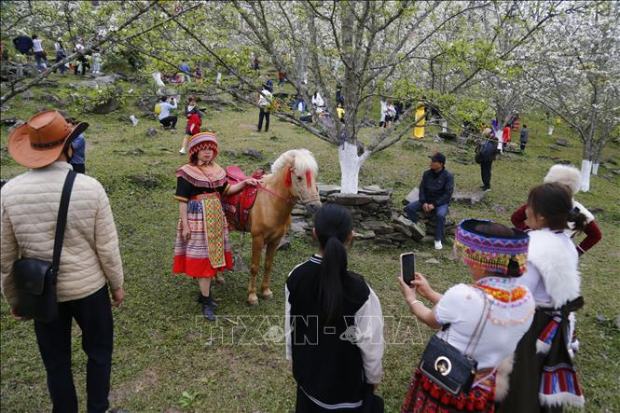
Capital Mobilization Solutions
The project is expected to mobilize initial funding from provincial technology funds and tourism organizations.
Additional sources include startup support funds for students, credit capital from banks,…

Slide 17
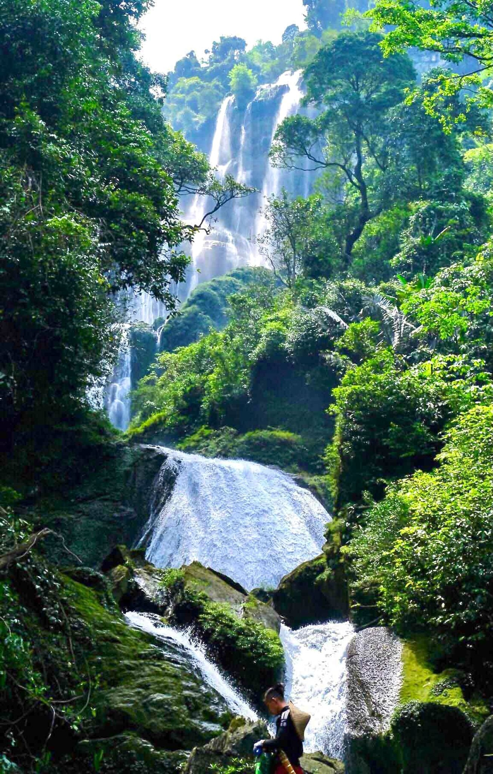
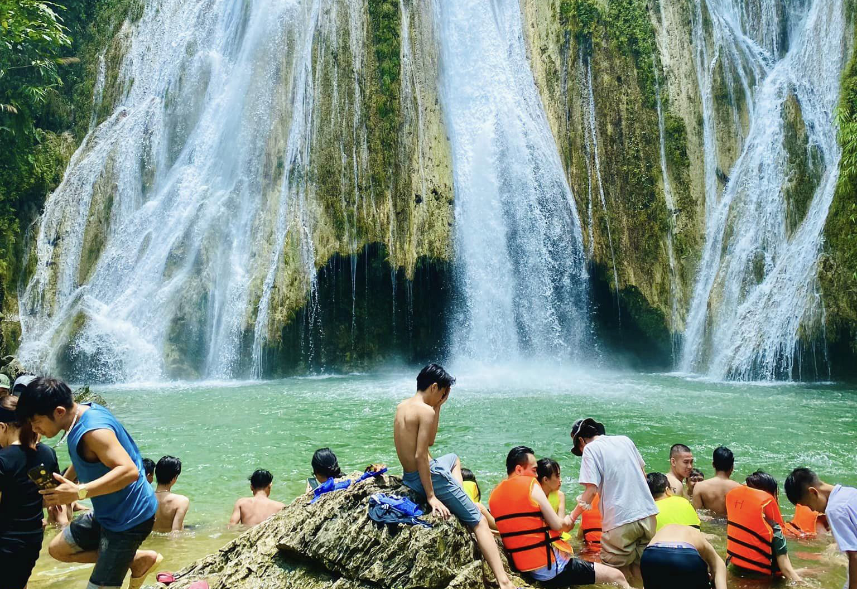
V. Risk Analysis and Assessment
*) Advantages
Tuyen Quang Province has significant untapped tourism potential.
The growing development of the Internet allows tourists to access information easily.
High demand from modern tourists for personalized experiences.
The readiness of the local community and the tourism workforce in Tuyen Quang Province to participate.
Potential support from provincial policies for tourism conservation and development.
*) Challenges:
Building trust with customers and service providers.
Market development and competition with established tourism platforms.
High initial investment costs for system development and operation.
Ensuring quality across all activities.

Slide 18
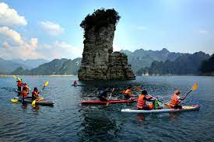
Technical Risks:
System Failures:
System crashes or downtime.
Software updates causing disruptions.
Server connectivity issues.
Data Security:
Information leakage or compromised user payment data.
Market Risks:
Competition:
Rivalry with established travel companies and freelance guides.
External Factors:
Epidemics, natural disasters, or economic downturns reducing tourist numbers.
Financial Risks:
Unexpected Costs:
Additional expenses leading to cash flow shortages.
Increased costs for market expansion.
Service Cancellations:
Refund requests or cancellations causing financial losses.

