Slide 1


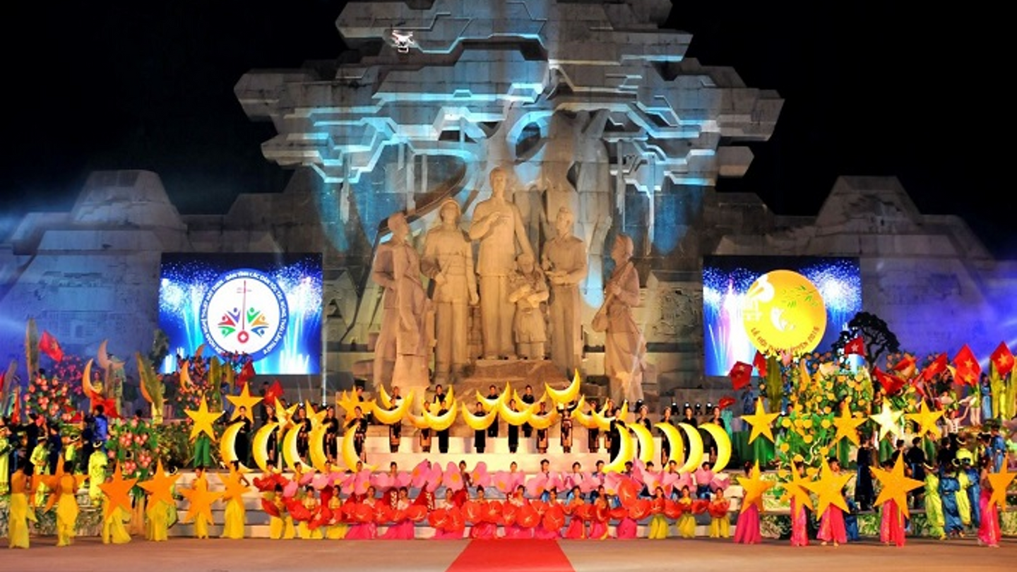
MARKETING MID-AUTUMN FESTIVAL IN TUYEN QUANG PROVINCE
Living Lab Project
Preserving Tradition and Promoting Cultural Tourism

Slide 2
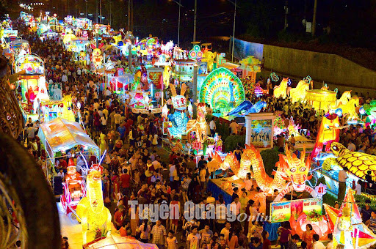
INTRODUCTION
Tuyen Quang Mid-Autumn Festival stands out as one of the most distinctive celebrations in the mountainous region of Northern Vietnam. Held annually on the full moon night of the eighth lunar month, the festival honors family bonds, unity, and love for children. The streets are adorned with vibrant lanterns, casting a dazzling and enchanting glow. Traditional activities, including lion dances, Chau Van singing, lantern parades, and various folk games, help foster a lively and festive atmosphere, drawing in numerous visitors
PROJECT OBJECTIVE:
Explore and implement marketing strategies to enhance Tuyen Quang’s cultural tourism brand.

Slide 3

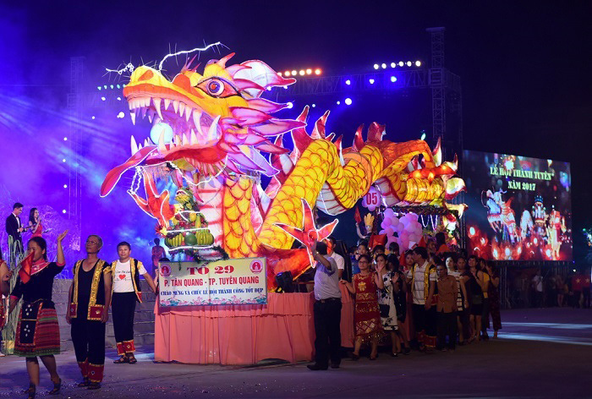
CURRENT STATE OF THE FESTIVAL
  Participants: Families, groups, and tourists from nearby provinces.
  Activities: Lantern parades, folk games, and traditional performances.
  Challenges: Maintaining order during events and balancing modern elements with tradition

Slide 4
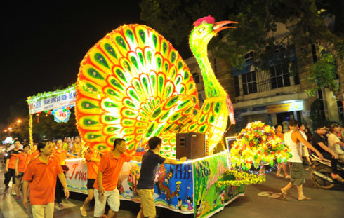

MARKETING STRATEGIES
  Online Promotion: Social media campaigns with engaging content.
  Outdoor Advertising: Eye-catching billboards in strategic locations.
  Events and Workshops: Pre-festival activities like lantern-making classes.
  Collaboration with KOLs: Partnerships with influencers to reach wider audiences

Slide 5




PROPOSED ACTIVITIES
Branding and Merchandising: Develop themed merchandise like lanterns and T-shirts
Collaboration is crucial for success. Local government provides policy support, businesses contribute sponsorships, and communities participate through crafts and performances. Media partners will amplify our promotional efforts
Interactive Experiences: Cooking mooncakes and participating in folk games
Community Engagement: Involve locals in sharing cultural stories and traditions

Slide 6
RESEARCH METHODS
  Indirect: Analyze existing marketing strategies (SEO, email marketing, etc.).
  Direct: Field observations and feedback collection during festival activities

Slide 7

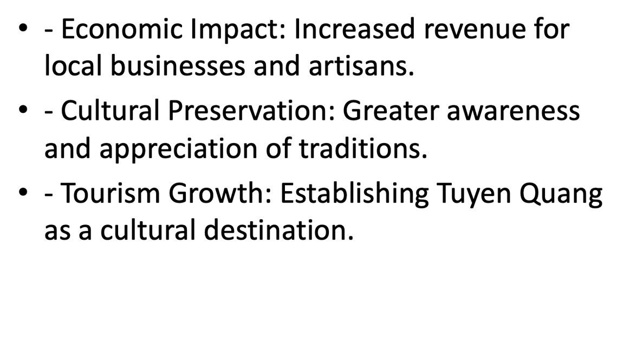
EXPECTED OUTCOMES
we anticipate increased festival attendance and local revenue growth. Long-term goals include establishing Tuyen Quang as a cultural tourism hub and fostering sustained community involvement in festival activities

Slide 8
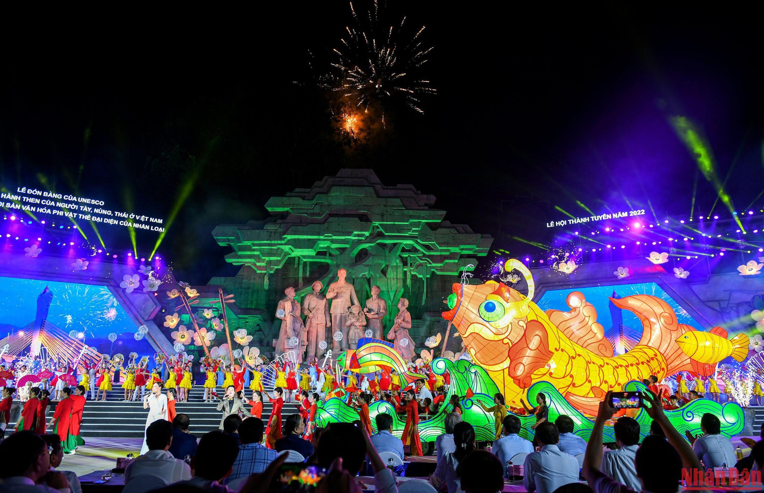
CONCLUSION
Marketing the Mid-Autumn Festival in Tuyen Quang is an opportunity to celebrate culture, drive tourism, and build community pride. Our next steps include launching pilot campaigns and refining strategies based on feedback. Let’s work together to make this vision a reality

Slide 9
THANK YOU

