Slide 1
Living lab Project
DIVERSIFYING PRODUCTS USING GRAPEFRUIT (POMELO)
GROUP 3
Course: Macro-Economics Instructor: Hoàng Anh Đào | Triệu Thủy Nguyễn Trâm Anh (Leader) Dương Hồng Ánh Trịnh Phương Ánh Hoàng Ngọc Duy (Presenter) Nông Minh Quý Vũ Yến Nhi

Slide 2
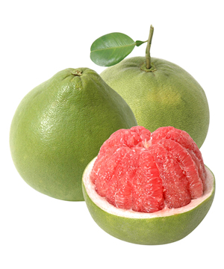
NECESSITY OF THE LIVING LAB PROJECT
With the advancement of science, technology, and the government's new policies for rural economic development, many localities have invested in large-scale crop and livestock projects. Among these, the expansion of grapefruit cultivation has gained significant attention from the media and press. Currently, there are 36 grapefruit-growing regions across 10 provinces in Vietnam, with notable areas including Tuyen Quang, Phu Tho, Bac Giang, and others.

Slide 3
NECESSITY OF THE LIVING LAB PROJECT
Grapefruit is a fruit with high nutritional value, and producers can create a variety of products from it. In particular, beverages made primarily from grapefruit—a fruit that provides a refreshing sensation on hot summer days—are not only enjoyable but also beneficial to human health. Grapefruit is rich in Vitamin C, which enhances the immune system, Vitamin A, which protects the body against infectious diseases and improves inflammation, as well as Vitamin B and other nutrients.
Bottled grapefruit juice will serve as a refreshing drink, meeting the essential needs of consumers while supporting their health and well-being.

Slide 4
II. MARKET ANALYSIS
Context | Advantages | Disadvantages
Political | Local areas encourage the development of production related to this product. | Priority is given to the development of technology and technical skills.
Economic | The agricultural economy is linked to abundant regional resources. | Limitations in modern industrial technology.
Social | People have farming experience. | Segmentation according to crop types.
Competitive | Beverages enriched with additional nutrients and vitamins benefit health. | Competition exists with many other beverage products.
Technological | - | Production technology remains limited.

Slide 5
II. MARKET ANALYSIS
Competitive Advantages
High-Quality Raw Materials: The main ingredients are carefully selected grapefruits harvested from Doan Hung district in Phu Tho province and Phuc Ninh commune in Yen Son district, Tuyen Quang province. These include the special green-skinned grapefruit variety, known for its eye-catching color and high antioxidant content.
Regional Specialty Value: The beverage not only serves essential human needs but also carries the unique identity of regional specialties, adding cultural and economic value.
Advanced Processing Technology: Modern machinery, such as the SODA Plus carbonation system, is utilized in the production process, offering a completely new flavor that stimulates the palate while preserving the product's quality.
Innovation and Modernity: This is a novel beverage that combines creativity and the application of advanced technological machinery, setting it apart in the market.

Slide 6
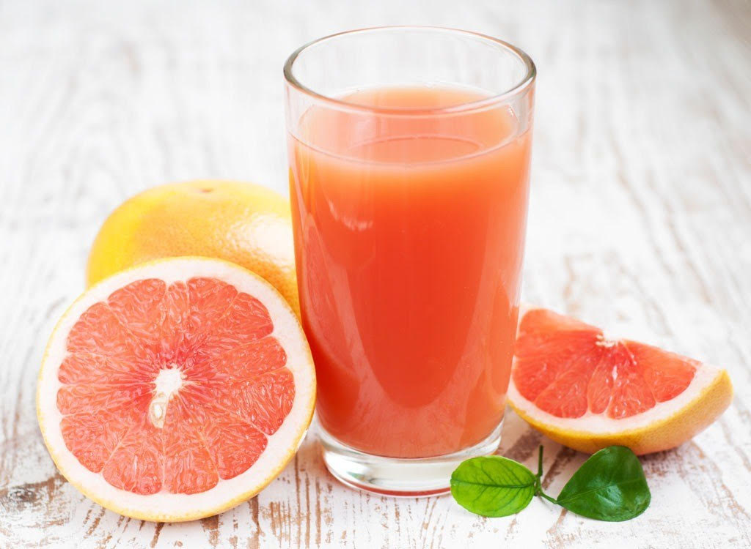
II. MARKET ANALYSIS
Risk Analysis and Solutions
Potential Risks:
Short Shelf Life: The product’s preservation is dependent on external factors such as weather, usage duration, and storage conditions.
Higher Price: Grapefruit juice may have a higher price compared to other common fruit juices.
Inconsistent Quality: Variations in the taste of grapefruits can occur due to factors like light exposure, temperature, and subjective user perception.

Slide 7
II. MARKET ANALYSIS
Mitigation Strategies:
Proper Storage: Ensure the product is stored in a refrigerator within the recommended time frame to maintain freshness.
Quality Management: Regularly inspect and monitor the quality of raw materials to minimize the risk of inconsistent product quality.
Use of Advanced Technology: Incorporate SODA Plus carbonation machines to enhance the beverage's flavor, improve shelf life, and ensure a consistent quality experience.
Research and Development (R&D): Invest in R&D to continually improve product quality and innovate with new product variations.
Pricing and Promotions: Offer competitive pricing that reflects the product's value while providing discounts and promotions to attract and retain customers. Highlight the cultural significance of the product to increase its perceived value.
Legal Compliance: Adhere to all business regulations and legal standards to avoid potential legal issues and ensure customer trust.

Slide 8
III. PROJECT DESIGN
(1) Product to be Implemented:
Bottled grapefruit juice.
(2) Objectives and Prospects of the Project:
Combine consumer demand for healthy products that improve quality of life with the value of a fruit recognized as a regional specialty.
Contribute to the province's development by providing safe beverage products during the production process.
Support agricultural output for localities producing raw materials for manufacturing.
Distribute products to the market through intermediaries and direct supply to beverage shops, street vendors, etc.
In the 4.0 era of industrialization and modernization, where the focus shifts towards nutrition and services, fruit juice is a product likely to be highly favored and consumed.

Slide 9
III. PROJECT DESIGN
(3) Implementation Methodology:
a. Required Tools:
Masks, gloves, knives, plates, plastic bottles, glass bottles, water-filling funnels, and graduated measuring cups.
Slow juicer (cold-press juicer).
SODA Plus carbonation machine and gas bombs.
b. Main Ingredients: Grapefruits from Phuc Yen Commune, Yen Son District, Tuyen Quang Province, and Doan Hung District, Phu Tho Province.
c. Secondary Ingredients: Granulated sugar and bitterness-removal agents.

Slide 10
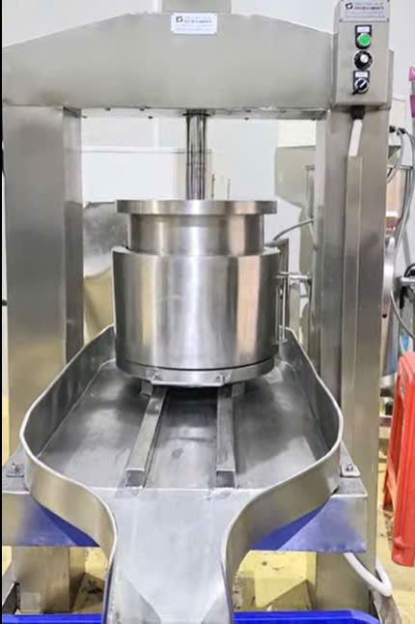
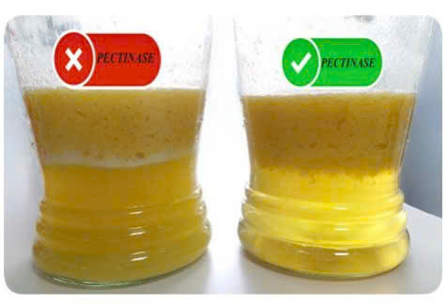
SELECTION OF RAW MATERIALS
Ensure proper weight and internal quality.
Avoid factors that may negatively impact the input materials.
JUICING WITH
A HYDRAULIC PRESS
ENZYME TREATMENT PROCESS
Cloudy Juice Due to natural Pectic Substances
Solution: Use pectinase enzyme to break down pectic substances, resulting in clearer juice and improved shelf life.
FILLING AND BOTTLING The grapefruit juice will be poured into bottles or containers using professional liquid packaging machines with pre-set volume settings on the machine.

Slide 11
(4) Marketing Plan
Build Brand Presence on Social Platforms: Leverage social media platforms to create a recognizable and engaging brand image.
Promotional and Marketing Activities: Offer discounts, promotions, and vouchers to attract buyers, tapping into consumer psychology.
Product Awareness Campaigns: Organize events to promote the product, highlighting its benefits for both consumers and producers.
Customer Engagement and Networking:
Encourage referrals and build relationships with acquaintances to grow the customer base.
Retain loyal customers while identifying potential ones to expand the product's reach.
Discount and Loyalty Programs: Introduce promotions like 10%-20% off, "Buy 2, Get 1 Free," or loyalty discounts for bulk purchases and frequent buyers.

Slide 12
IV. PROS AND CONS OF THE PROJECT
Pros:
Abundance of High-Quality Raw Materials: Tuyen Quang province is known for its pomelo cultivation, providing an ample supply of fresh, high-quality fruit, including specialty varieties like green-skinned pomelos.
Health Benefits of the Product: Pomelo juice is rich in nutrients such as Vitamin C, antioxidants, and other essential vitamins, appealing to health-conscious consumers.
Market Potential: Increasing demand for healthy and natural beverages aligns with the global trend toward wellness and sustainable living.
Regional Specialty Appeal: Bottled pomelo juice can be marketed as a regional specialty, adding cultural and economic value to the product.
Environmental Sustainability: Utilizing locally grown pomelos supports sustainable agriculture and reduces the carbon footprint associated with transportation of raw materials.
Economic Development: The project can boost the local economy by creating jobs for farmers, production workers, and distribution networks.
Technological Advantage: Modern machinery, such as hydraulic presses and carbonation machines, ensures consistent quality and innovative product variations.

Slide 13
IV. PROS AND CONS OF THE PROJECT
Cons:
Short Shelf Life: Pomelo juice, being a natural product, may have a limited shelf life unless preservatives or advanced preservation methods are used.
High Production Costs: Equipment like hydraulic presses and carbonation machines, along with the use of high-quality pomelos, may increase production costs, potentially making the product more expensive than competitors.
Quality Inconsistencies: Variations in pomelo flavor and quality due to environmental factors (e.g., climate, soil) can impact the consistency of the final product.
Consumer Awareness: Introducing a new product in the market may require significant investment in advertising and consumer education.
Competition: The beverage market is highly competitive, with numerous established brands offering fruit-based juices, making it challenging to establish a foothold.
Logistical Challenges: Ensuring proper storage and transportation to maintain product quality can be difficult and costly, especially in remote areas.
Regulatory Compliance: Adhering to food safety and business regulations requires meticulous planning and may increase administrative burdens.

Slide 14
The bottled pomelo juice project in Tuyen Quang province holds significant potential due to the availability of quality raw materials, health benefits, and market trends favoring natural beverages. However, addressing challenges like production costs, quality consistency, and competition will be critical to ensuring the project's success. Strategic marketing, technological innovation, and strong local partnerships can help mitigate these risks and maximize opportunities.

