Slide 1
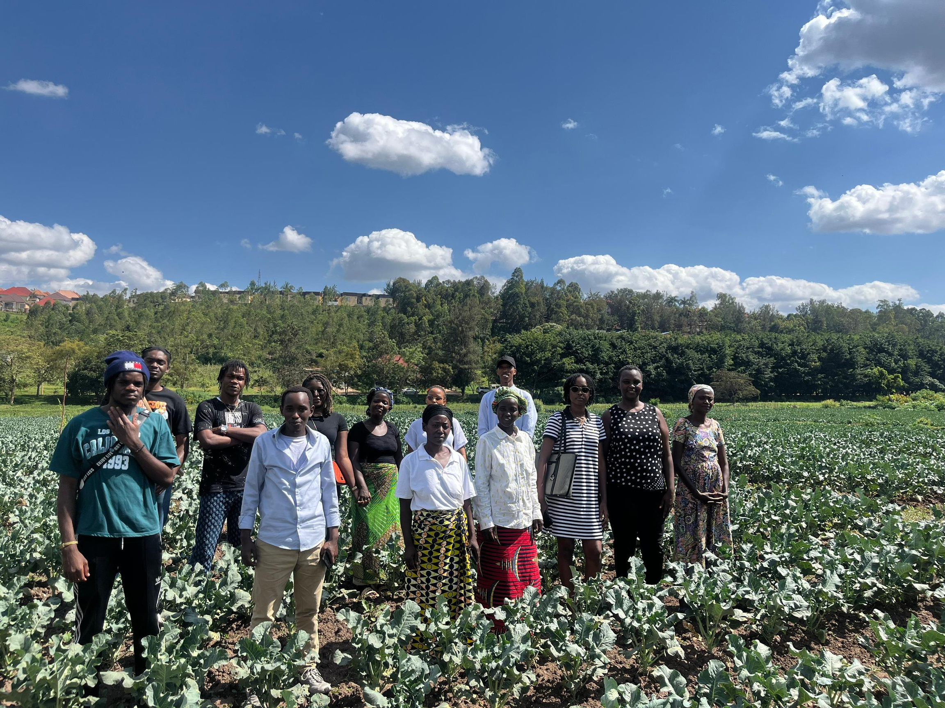
PASSING THE TORCH
KNOWLEDGE TRANSFER OF RWANDAN MEDICINAL PLANTS ACROSS GENERATIONS
Marks: 17

Slide 2

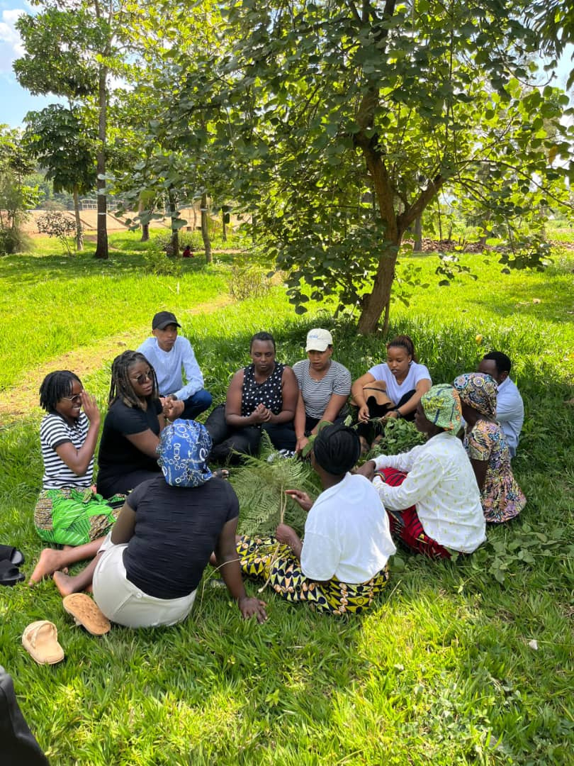
WHY THIS
PROJECT?
A STUDENT-LED RESPONSE TO A CRITICAL CHALLENGE
  Rwanda’s medicinal plants are disappearing
  Human activities like deforestation and urbanization are the main causes
OUR MISSION
  Create a digital archive to protect plant wisdom
  Safeguard this heritage for future generations
OUR VISION
  Connect traditional practices with modern science
  Keep ancestral knowledge alive and relevant

Slide 3
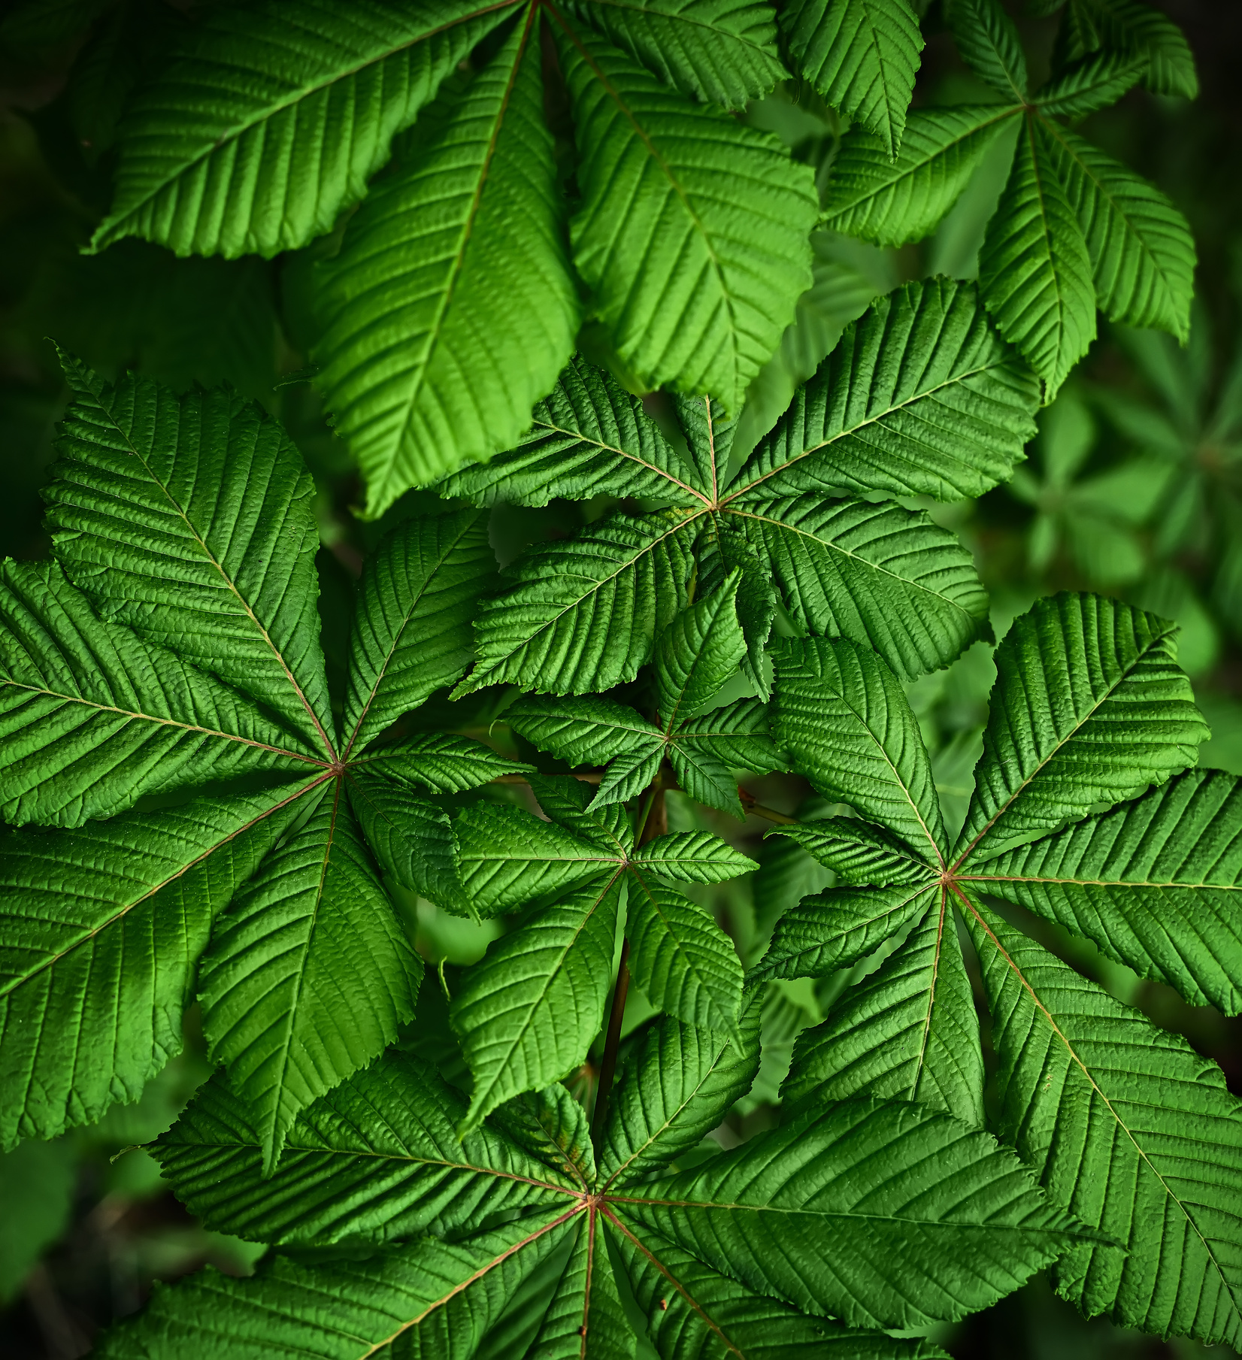
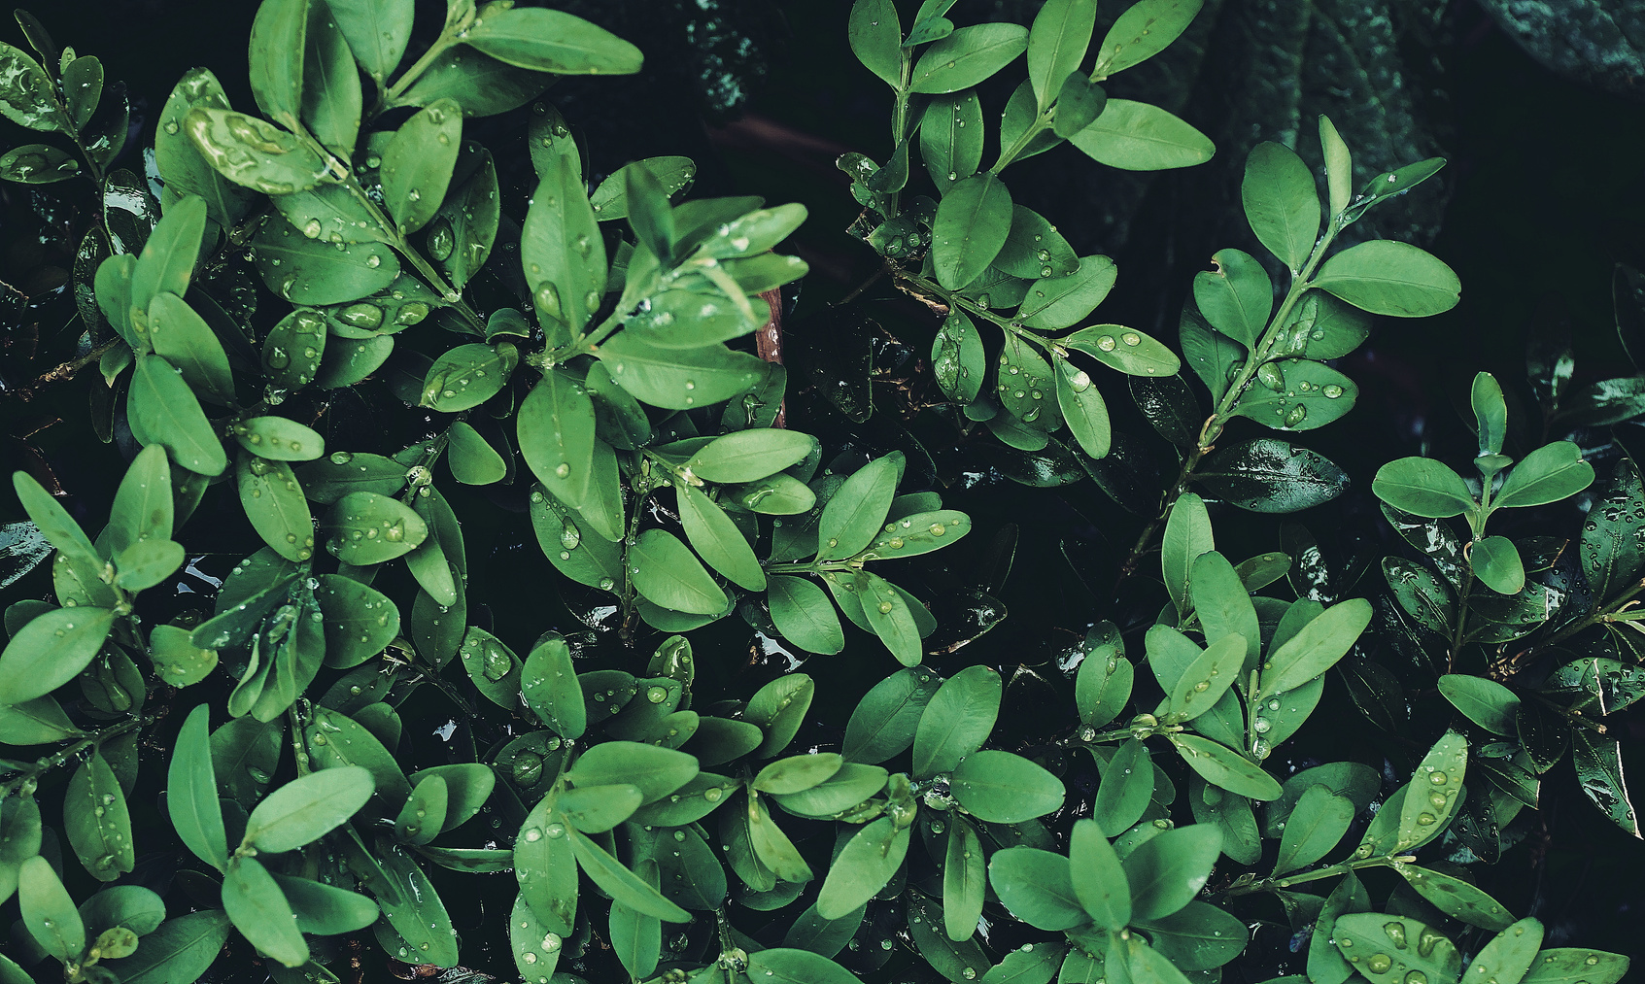
IDENTIFIED
PROBLEM
Medicinal plants have played a vital role in traditional healing for centuries, holding generations of ancestral wisdom. However, this precious heritage is now at risk due to modernization, shrinking natural habitats, and a growing disconnect between elders and younger generations. Without action, this knowledge could disappear, leaving future generations without access to nature’s healing gifts.

Slide 4
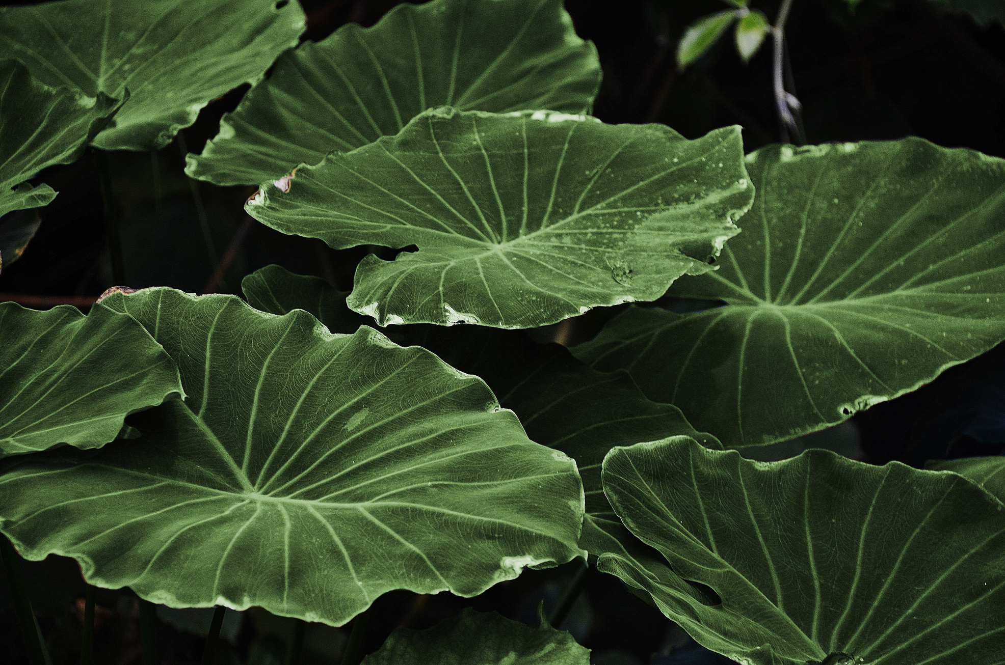
PROJECT
PURPOSE
✨
  ✨ Ensure this knowledge lives on
  Create opportunities for education, innovation, and community empowerment
TACKLE THE URGENT LOSS OF RWANDA’S MEDICINAL PLANT KNOWLEDGE
  Threatened by deforestation, urbanization, and modernization
  Traditional wisdom at risk due to shrinking habitats + generational gaps
SAFEGUARD ANCESTRAL PLANT WISDOM
  Build a bridge between elders and youth
  Honor and preserve cultural identity through plant heritage
CONNECT TRADITION WITH MODERN SCIENCE
  Combine ancestral practices with scientific research
  Provide a foundation for future studies on plant efficacy

Slide 5
OUR CORE
OBJECTIVES
PRESERVE TRADITIONAL KNOWLEDGE
Work with elders, healers, communities
Document names, traits, uses, rituals
CREATE DIGITAL ARCHIVE
Virtual herbarium
Interactive maps + searchable database
PROMOTE SUSTAINABLE TOURISM
Cultural, eco, wellness, and virtual tourism

Slide 6
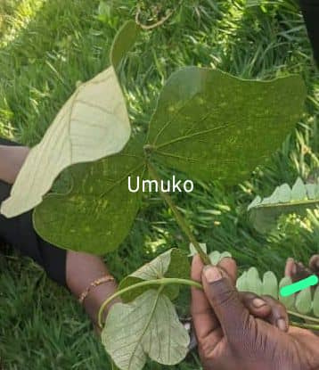
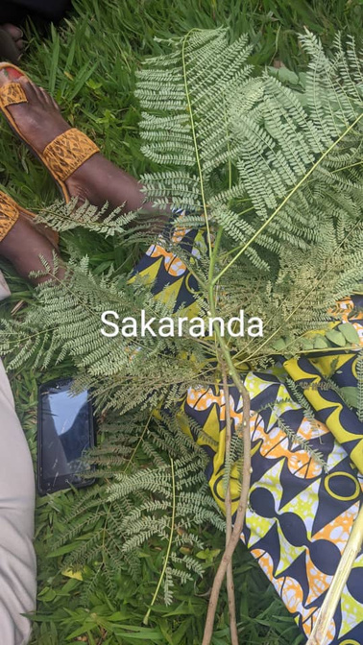
MEDICINAL PLANT GALLERY
UMUKO(BAUHINIA THONNINGII)
  wound healing and skin infections
  Treats coughs,bronchitis and sore throats
  treats diarrhea,stomachaches and intestinal worms
SAKARANDE(BRIDELIA MICRANTHA)
  treats stomach and intestinal worms (especially in children)
  Liver and kidney support, it acts as a detoxifier
  Malaria and fever treatment

Slide 7
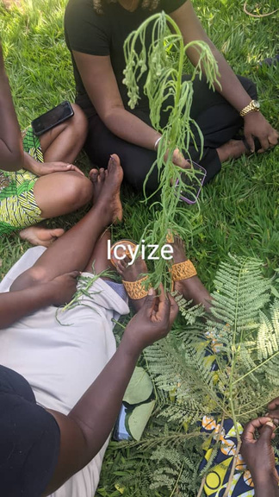
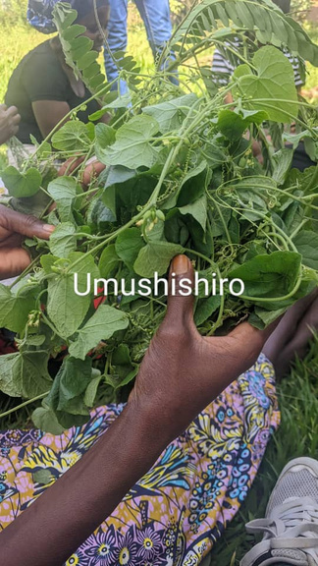
CONT
ICYIZE(TETRADENIA RIPARIA)
  treats toothache and acts as antiseptic for the mouth
  used as a mosquito repellent
  it reduces fevers especially malaria fevers
UMUSHISHIRO(VERNONIA AMYGDALINA)
  Helps lower blood glucose levels
  it acts as anti bacterial, antifungal and anti- inflammatory
  it strengthens the immune system and fights off infections

Slide 8
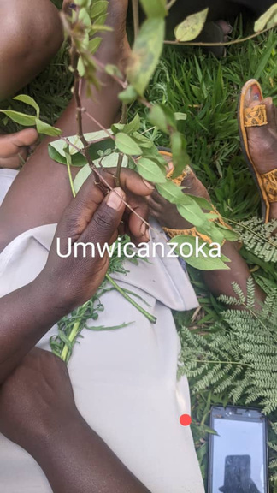
CONT
UMWICANZOKA(CHENOPODIUM AMBROSIOIDES)
  it is anti-parasitic(deworming) especially in children
  treats indigestion, gas,bloating ,stomachaches and stimulates appetite
  used for rheumatism, joint pains and general body aches
  treats chest congestion and asthma

Slide 9
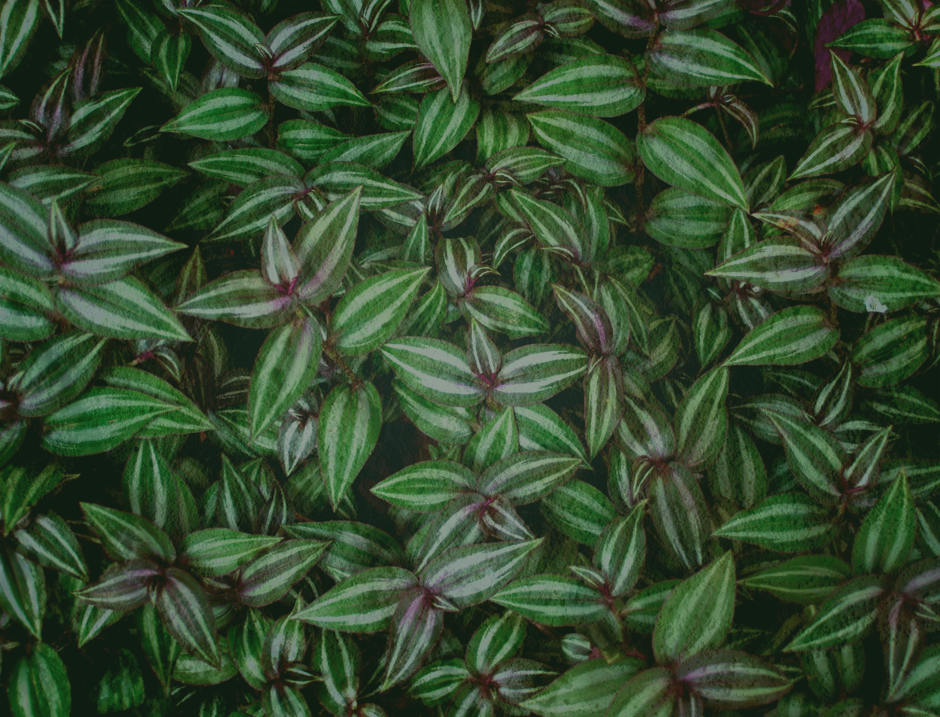
THE TEAM
JOSEPHINE KAMAREBE (LEAD)
20542/2022
PLAISIR NISHIMWE
20738/2022
PEACE MASENGESHO
20611/2022
HERVE GATERA
20566/2022
MINANG MI OBIANG CARL
21311/2023
PAMBOU BOUNDA MICHEL BRIEL
20316/2022
OPAPE REMANDJI CHARLES PATRICK
20385/2022
ADA NDONG FRANYA
20637/2022
RUKUNDO ERIC
20826/2022
OMANDA NDELO MORGANE
20091/2022

Slide 10

THANK YOU

