Slide 1
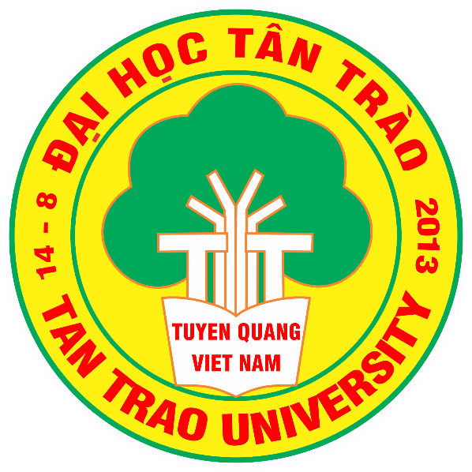
TAN TRAO UNIVERSITY
FACULTY OF ECONOMICS AND BUSINESS ADMINISTRATION
*********
LIVING LAB PROJECT:
ECOCHICK BAGS – HANDMADE BAG BUSINESS FROM RECYCLABLE WASTE
Course: Macro-economics
Lecturer: Hoang Anh Dao
GROUP 2
Trần Thị Kim Ngân (Presenter)
Hoàng Yến Ngọc
Phạm Thị Hồng Nhung
Lê Thị Thu Thảo
Nguyễn Thanh Thảo
Bùi Thị Thu (Leader)
Dương Bích Thủy

Slide 2
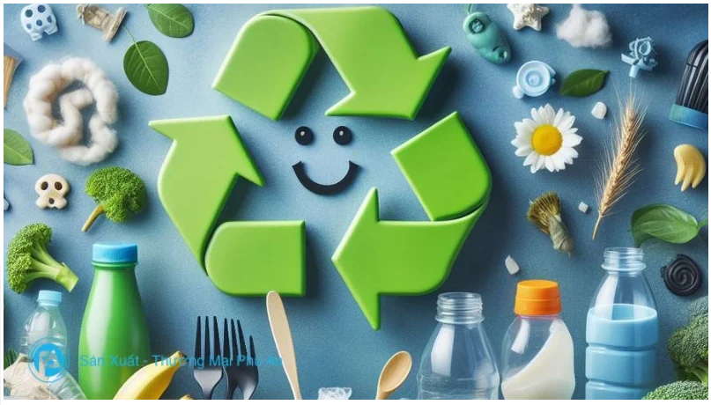
I. Project Summary
Main Idea of the Project: Business of handmade bags from recyclable waste.
Product Description
EcoChick Bags offers a sustainable solution to the fashion industry by recycling old clothing and plastic waste into unique and stylish handbags. Using materials such as denim, nylon, polyester, or Gore-Tex, each product is not just a fashion accessory but a piece of art, showcasing creativity and a commitment to environmental protection.
EcoChick Bags promotes sustainable consumption, contributing to a greener future and fostering awareness to protect the planet.

Slide 3
II. The Necessity of the Project
EcoChick Bags is an innovative startup project focusing on producing sustainable and stylish fashion bags to minimize fashion and plastic waste. The project utilizes old clothing and recycled plastic waste to create unique, high-quality, and environmentally friendly products.
EcoChick Bags targets young people, homemakers, and environmentally conscious individuals, offering creative designs, diverse materials (such as denim, nylon, polyester, and Gore-Tex), and affordable pricing. Each bag is not just a fashion accessory but also a symbol of personal style and a positive contribution to environmental protection.
The project helps reduce landfill pressure and conserve natural resources while lowering CO₂ emissions from the production of new materials. Additionally, EcoChick Bags promotes the green living movement through media campaigns and educational activities. It also creates job opportunities for people in disadvantaged areas, especially women, by providing vocational training and employment.
With its meaningful brand story, EcoChick Bags is not just a business initiative but also a source of inspiration for communities and businesses in environmental responsibility, circular economy, and sustainable living. This project promises to make a significant contribution to the sustainable development of society.

Slide 4
III. BUSINESS CANVAS MODEL
Key Partners | Key Activities | Value Propositions | Customer Relationships | Customer Segments
Fashion store Designer, tailor Individual customers Supermarket | Running a handmade bag business by recycling pre-used clothing. Organizing workshops for young people to design unique bags and raise awareness about environmental protection. Accepting custom bag orders and providing bag-making kits. | Transform unused clothing into aesthetically pleasing fashion products with high emotional value. Minimize waste generated by fast fashion trends. Promote a circular economy and raise awareness about environmental protection. | - Building community-oriented customer relationships | - Target audience: Dynamic youth who love creative fashion. - Psychology: Customers prioritize eco-friendly products and want to preserve memories by recycling items into new products.
MARKETING AND DISTRIBUTION CHANNELS | COST STRUCTURE | REVENUE
Online communication and distribution on platforms such as Facebook, TikTok, Tiki, Shopee, etc.Direct distribution channels: Wholesale and retail sales. | Fixed Costs: Machinery, equipment, and operational management software costs Marketing expenses Sales and service delivery expenses Variable Costs: Transportation costs Direct material costs Tools and supplies expenses | Selling handmade bags made from recycled waste. Offering experiential services for customers to sew and design bags from fashion waste and recycled plastics. Selling bag-making materials to customers in need.

Slide 5
Production Feasibility:
The production of bags from recycled clothing is feasible because:
Accessible raw materials: Old clothes, fabric scraps, and recycled accessories are common, affordable, and can even be sponsored or collected from the community.
Simple sewing techniques: The products primarily require basic sewing, assembly, and creative design techniques.
Supportive market: The rising trend of sustainable consumption, especially among young people, ensures strong demand for the products.
2. Cost Structure and Pricing:
Production Costs:
The products are cost-effective, leveraging readily available raw materials and a skilled labor force.
Handmade bag production does not require high expenses or complex techniques.
With reasonable cost structures and competitive pricing, the project can achieve both economic and environmental sustainability.
Feasibility

Slide 6
Uniqueness and Creativity
Innovative materials: While recycled bags are already present in the market, the standout feature of this project is its use of not only denim but also other fabrics, particularly recyclable plastic waste, to create bag accessories.
Customer experience: A key differentiator is the opportunity for customers to personally experience making their own bags. This hands-on approach not only enhances the product's appeal but also raises public awareness about the value of recycled products.
Sustainability: By utilizing fashion waste and plastic waste, the project promotes a circular economy and makes a significant contribution to environmental protection.

Slide 7
IV. DESIGN OF PROJECT PLAN
STEP 1
Material Collection
STEP 2
Sketching Ideas
STEP 3
Material Processing
Organizing Collection:
Collaborate with organizations, individuals, and communities to collect old clothing and recyclable plastics.
Host collection events at public venues, schools, or residential areas to encourage participation.
Sorting Materials: After collection, categorize materials by type (fabric, plastic) and condition (ready-to-use, requires processing).
Design Sketches: Use paper or design software to sketch bag prototypes.
Accessory Listing: Create a list of required accessories (zippers, straps, etc.) to complete the design.
Cleaning:
Wash clothing and plastics thoroughly to remove dirt, odors, and impurities.
Use eco-friendly cleaning agents.
Cutting and Sewing:
Cut materials into the required sizes and shapes for bag design.
Ensure precision in cutting to facilitate seamless assembly later.
Assembling:
Arrange the cut pieces according to the design and begin stitching them together.
Utilize household sewing machines for efficient and precise assembly.
STEP 4
Product Completion, Quality Inspection, and Sales
Final Assembly: Complete the final stitching of the bag, including adding accessories like zippers, straps, and decorative elements.
Quality Inspection:
Examine each product for durability, aesthetics, and functionality.
Assess the bags to ensure they meet quality standards.
3. Feedback and Improvement: Record common defects or issues to refine and improve the production process in the future.
PROCESS OF PRODUCTION

Slide 8
Developing Distribution Channels
Solutions for Building Distribution Channels:
Develop an application to connect key partners, such as material suppliers, small-scale tailors, and consumers, into a broad network.
Utilize online communication and distribution platforms like Facebook, TikTok, Tiki, Shopee, etc.
Direct Distribution Channels:
Wholesale and retail sales.

Slide 9
Market Development and Expansion
Local Market Development:
Expand the market in Tuyen Quang province while exploring nearby regions and nationwide opportunities.
Partnering with Potential Businesses:
Seek potential partners such as souvenir manufacturers and premium gift businesses.
Enhanced Online Promotion:
Strengthen promotional efforts on online platforms to increase visibility and reach.

Slide 10
Resource evaluation
(1) Evaluation of Human Resources
Current Support and Capabilities:
The project has not yet received direct advice or support from large enterprises. However, collaboration with sustainable startup organizations, innovation support funds, or government agencies focusing on environmental protection is possible to gain guidance and consultancy.
The core team includes members capable of supporting sales and business management.
(2) Key Partners Supporting the Project:
Small-scale tailors: Collaborate with them to integrate resources into a wide network through the application platform.
Recycling organizations: Partner with fashion waste collection and processing organizations to ensure a steady supply of recycled materials.
Schools and families: Provide financial support to help initiate and sustain the project.

Slide 11
Resource evaluation
Capital Mobilization Solutions
Personal and Family Resources:
Utilize personal funds, bank loans, and financial contributions from relatives.
Startup Support Programs:
Seek incubator programs or startup support funds to secure additional capital.
Competitions and Sponsorships:
Participate in startup programs and competitions to attract sponsors while promoting products to a broader market.

Slide 12
1. Develop an Overall Communication Plan
Communication Objectives:
Raise awareness about sustainable fashion and the benefits of recycling clothing.
Increase brand recognition for EcoChick Bags in the market.
Attract potential customers and build customer loyalty.
Strategies:
Combine online and offline communication to maximize reach and effectiveness.
Highlight the brand story and sustainable values as central themes.
2. Build Communication Tools
Content Creation:
Share posts about the brand story, production process, and sustainable development values.
Social Media Platforms:
Facebook & Instagram: Focus on showcasing product images, videos of the recycling process, and interactive campaigns to engage customers.
TikTok: Create short, creative content such as recycling guides or transformations of old clothes into stylish bags.
Video Storytelling: Develop short films documenting the journey of an old piece of clothing being transformed into a beautiful bag.
V. COMMUNICATION CHANNELS

Slide 13
1. Advantages of Implementing the Project
Abundant raw materials: Old clothing, fabric scraps, and recyclable plastic waste are easily collected at low costs.
Market demand: The growing popularity of green living and sustainable consumption creates favorable conditions for product acceptance.
Personalization potential: Each bag is unique, appealing to customers who value creativity and individuality.
High promotional value: Environmentally friendly products inspire engaging social media campaigns, reducing marketing expenses.
VI. PROS AND CONS
2. Challenges in Project Implementation
Material collection: The quality of old clothing is inconsistent, potentially making it difficult to select and process materials.
Customer perception: Some customers may be unfamiliar with or skeptical about the quality of recycled products.
Competition: The bag market is crowded with both local and international brands, making it challenging to attract customers.
Recycling process: Processing and cleaning recycled materials require time and technical expertise, which can increase costs if not optimized.

